Slide 1
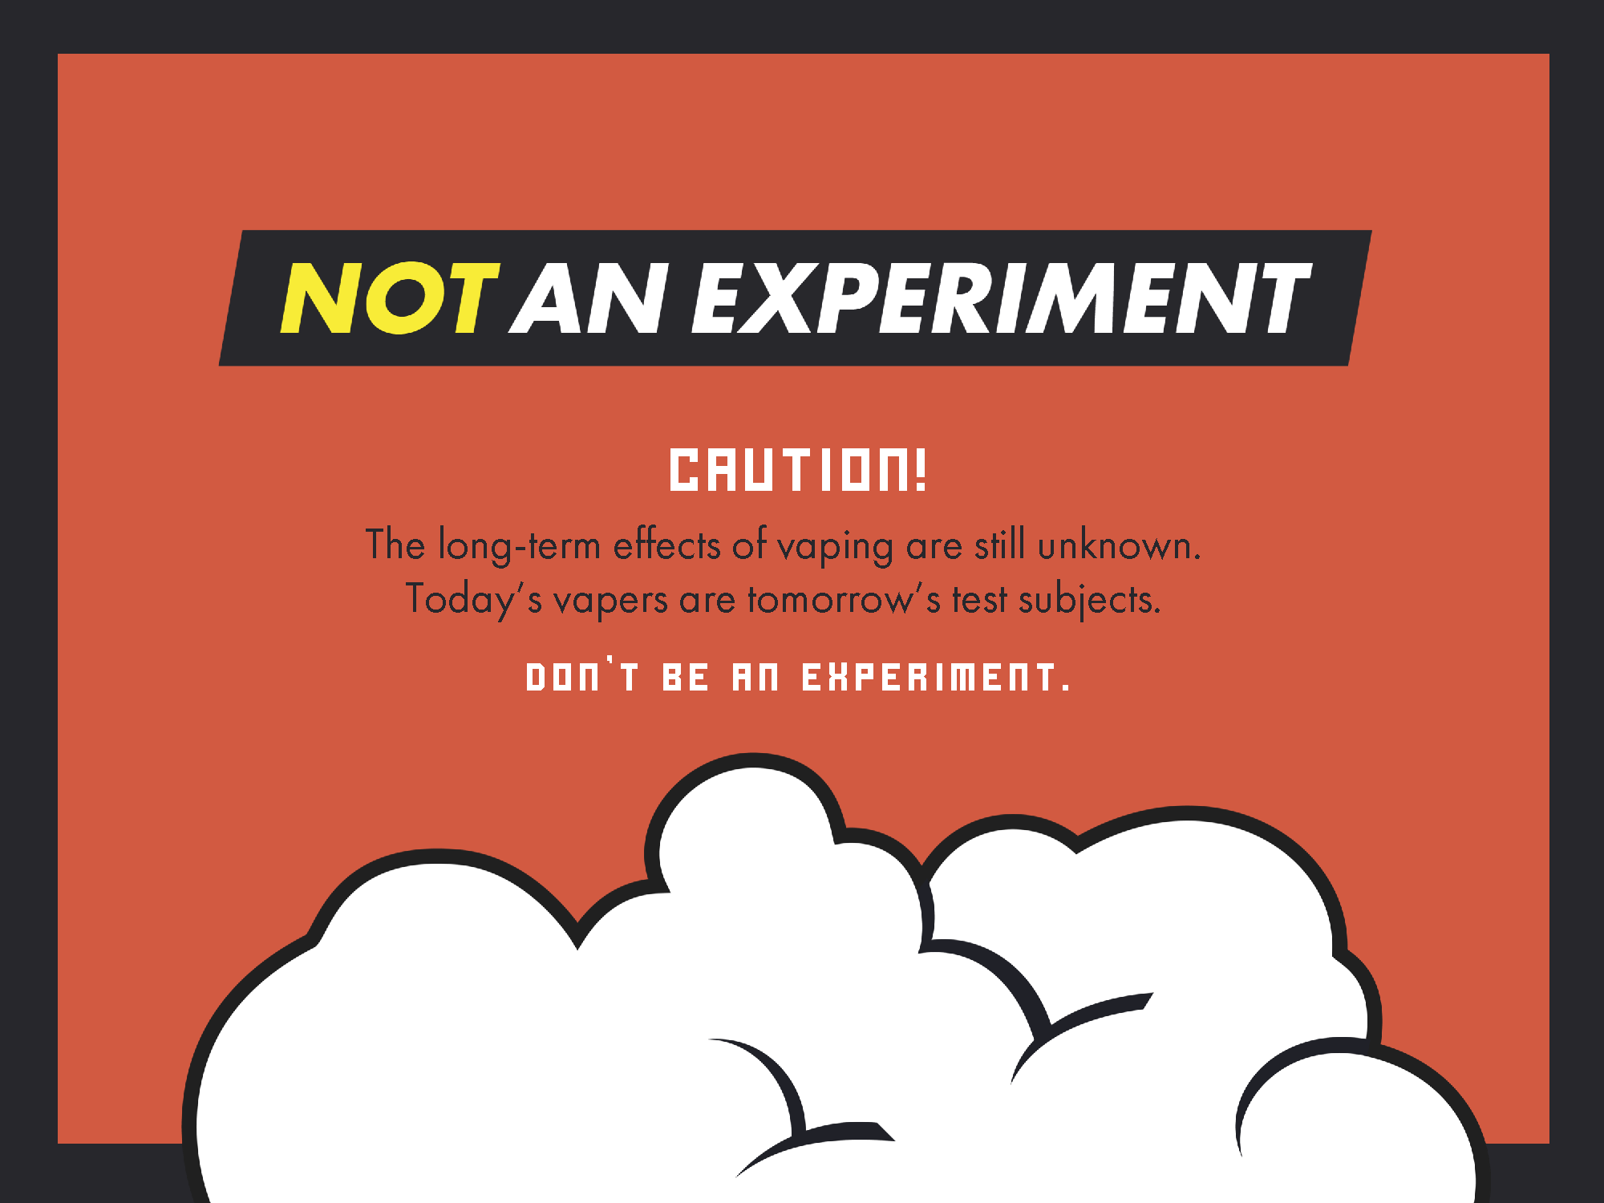

Slide 2
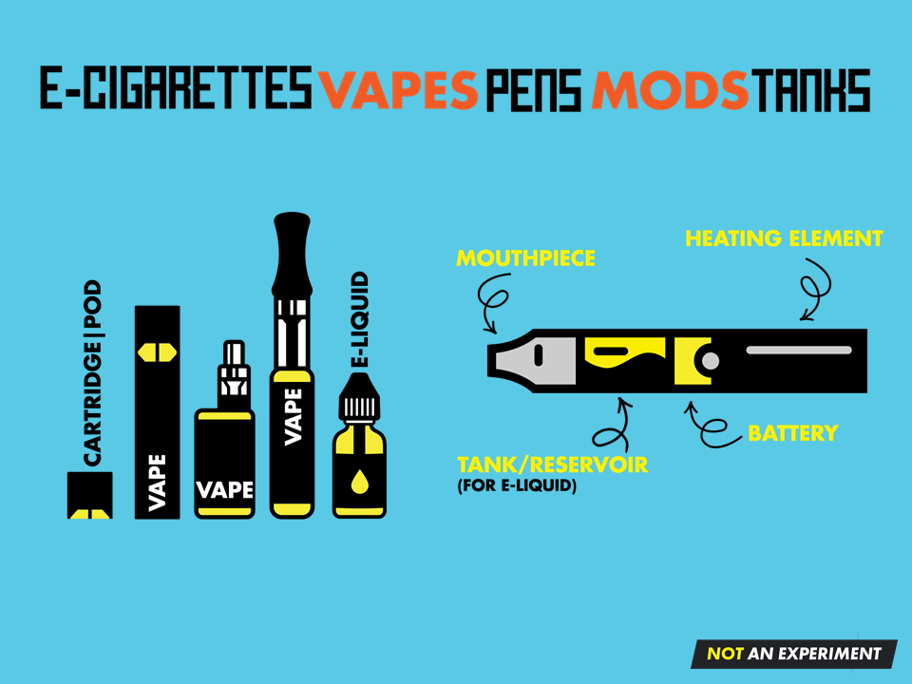
Notes:
Electronic cigarettes are battery operated devices that heat a liquid (e-liquid) until it vapourizes into an aerosol.
They come in many shapes and sizes from box-like devices to small flat sticks that look like USB drives.
All contain the same basic components: a mouthpiece, a tank or cartridge/pod for the vaping liquid, a heating element, and a battery.

Slide 3
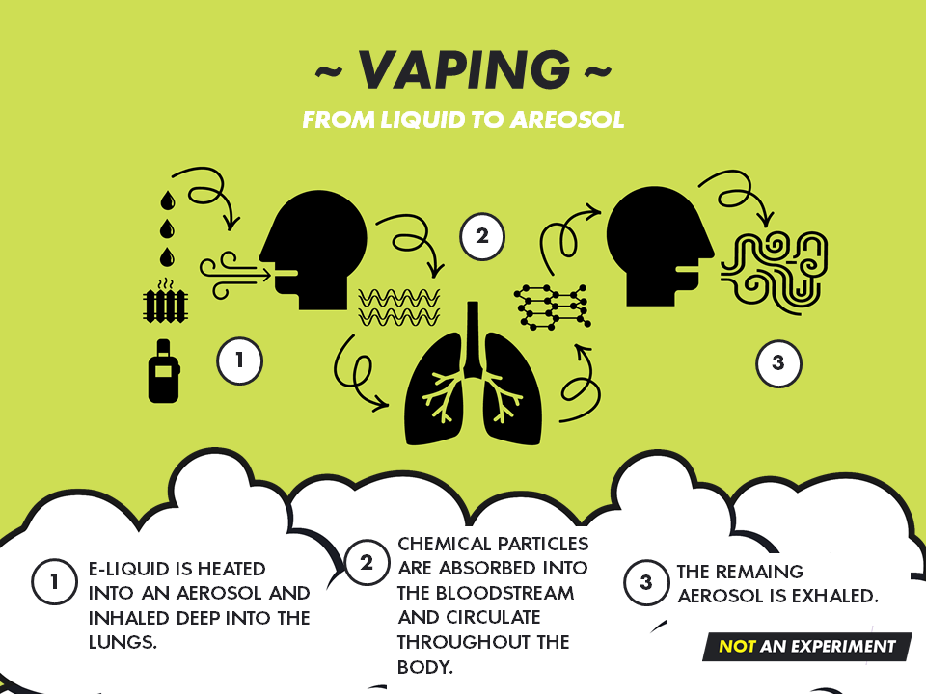
Notes:
Vaping involves inhaling and exhaling an aerosol produced by a vaping device.
The heating element heats e-liquid to the point at which it turns into an aerosol.
The aerosol is not just a harmless water vapour, it is a suspension (mixture) which contains many fine particles.
Once absorbed into the bloodstream, these particles travel to all parts of the body, including the brain.
The remaining aerosol is exhaled back into the air and appears as white smoke or “cloud”.

Slide 4
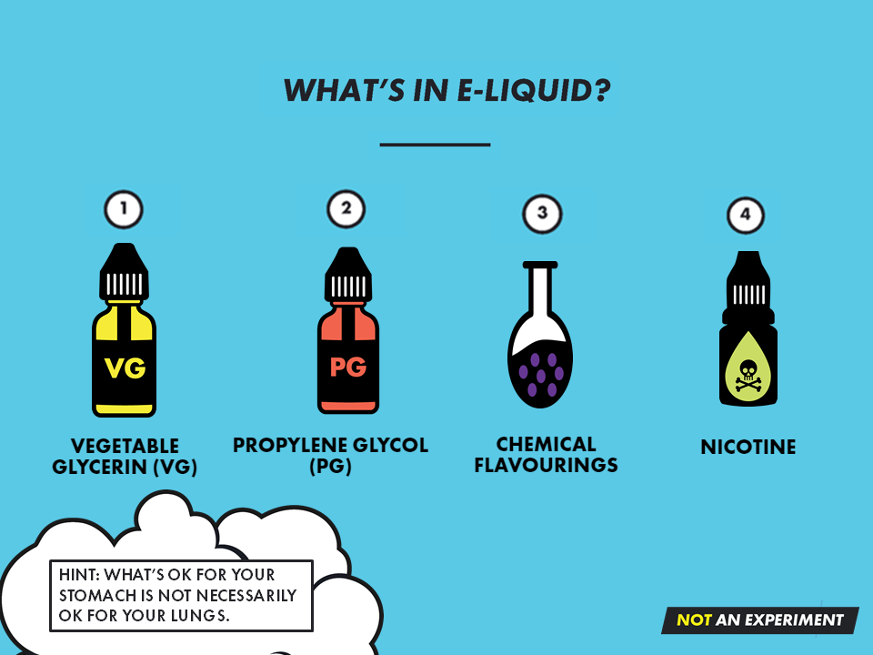
Notes:
There are 4 main ingredients in e-liquid:
Vegetable glycerin (VG) – Syrupy, sweet liquid used to emulsify or moisten food and cosmetic products. In e-liquid it helps to suspend flavouring and nicotine particles. It is considered safe to eat in small quantities but has not been proven safe to inhale when vaping.
Propylene glycol (PG) – Colourless, odourless liquid that acts as a preservative, thickener or emulsifier in food products. It is also found in industrial products like antifreeze and paint. It’s main function in e-liquid is to produce the white “cloud” that mimics cigarette smoke when a person exhales. This is also considered safe to eat in small quantities, but has not been proven safe to inhale when vaping.
Chemical flavourings – E-liquid comes in thousands of flavours. Despite fancy ads and labels showing pictures of delicious candy and fruit, all e-cigarette flavours are made from chemicals. These chemicals are generally considered safe to eat, but have not be proven safe to inhale.
Nicotine – This is the highly addictive drug that keeps users coming back for more. By turning nicotine into a salt, e-cigarette manufactures found a way to add a lot more of it to e-liquid compared to amounts found in cigarettes.

Slide 5
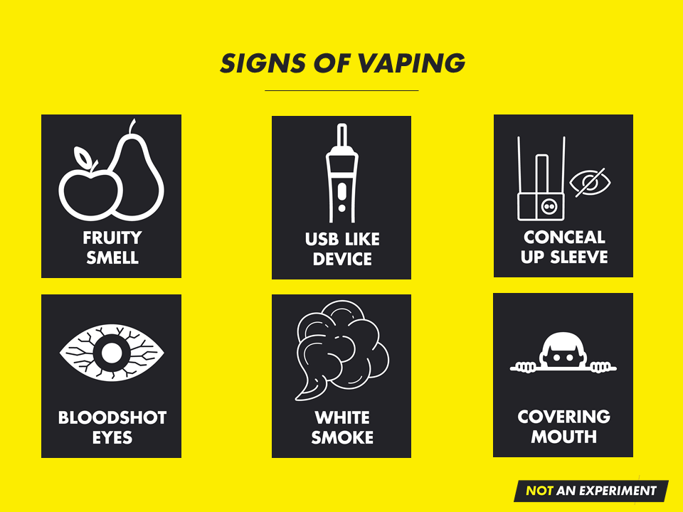
Notes:
Seeing a combination of any of the following may indicate someone is vaping:
Smelling fruit/sweet smells
Noticing unfamiliar USB drives or battery chargers
Appears to be concealing something up a shirt sleeve
Blood shot eyes
Seeing small or large clouds of white aerosol
Raising a shirt up over the face/mouth

Slide 6
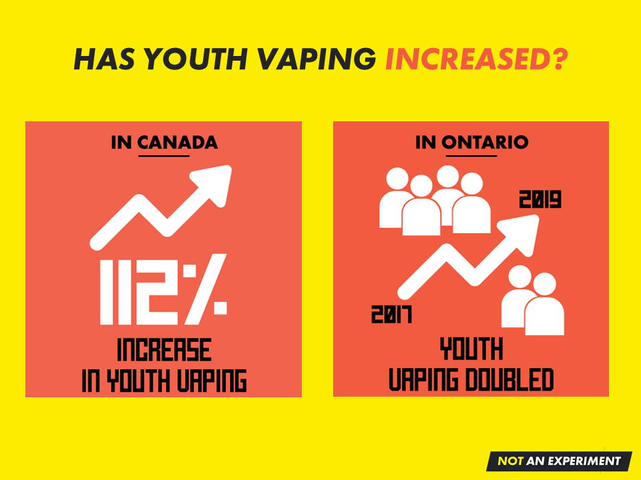
Notes:
Since coming onto the market in the mid-2000’s e-cigarette use has grown at an explosive rate, especially among non-smokers and youth.
Many people including parents and caregivers hear that vaping is less harmful than smoking cigarettes, but don’t recognize that vaping is not harm free.
Between 2017 and 2019 there was a 112% increase in vaping among Canadian youth aged 16-19 (8.4% to 17.8%) (1)
Between 2017 and 2019, past year e-cigarette use doubled among Ontario students in grades 7-12 (from 11% to 23%)/ (2)
References:
Hammond, D., Rynard, V. L., & Reid, J. L. (2020). Changes in Prevalence of Vaping Among Youths in the United States, Canada, and England from 2017 to 2019. JAMA paediatrics.
Boak, A., Elton-Marshall, T., Mann, R. E., & Hamilton, H. A. (2020). Drug use among Ontario students, 1977-2019: Detailed findings from the Ontario Student Drug Use and Health Survey (OSDUHS). Toronto (ON): Centre for Addiction and Mental Health.

Slide 7
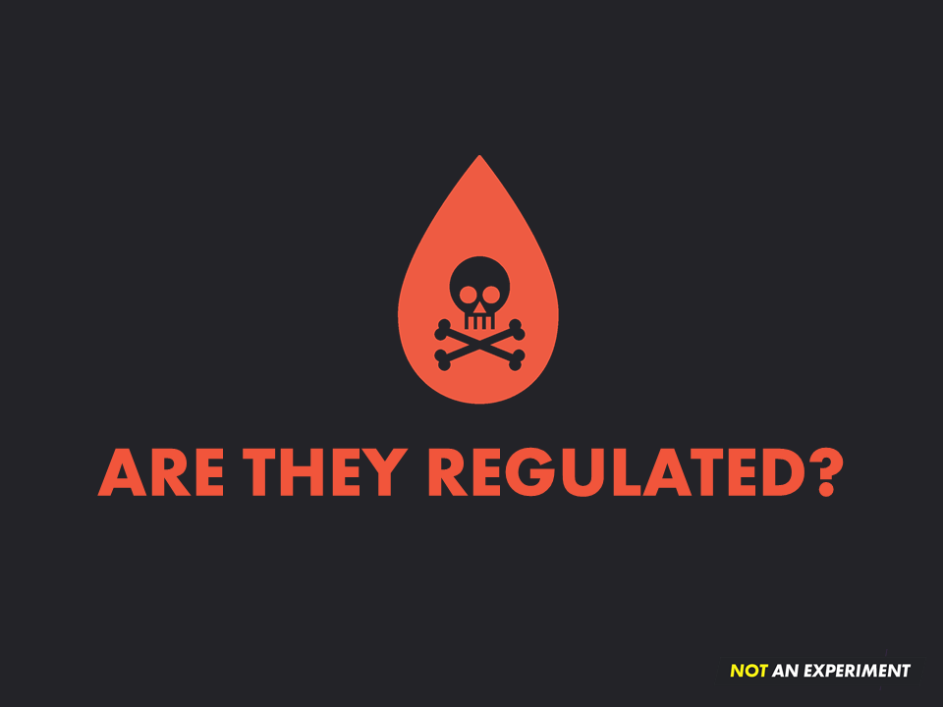
Notes:
E-cigarettes, e-liquid and cartridges/pods in Canada are controlled by federal and provincial restrictions.
Few regulations were placed on these products when they first came on the market.
However, as more is learned about the effects of using e-cigarettes, more measures are being put into place in order to protect people, especially youth.
For example, as of July 2020, the labels of all vaping products must now include:
A list of ingredients
Standardized health warnings
A standard nicotine statement

Slide 8
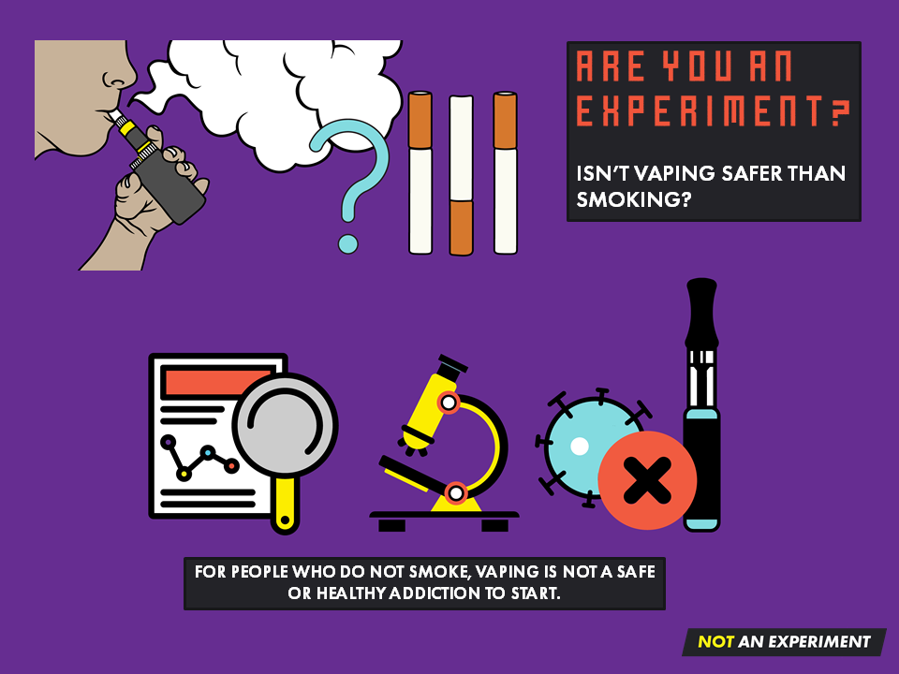
Notes:
E-cigarettes may be less harmful than cigarettes (8), but safer than cigarettes does not mean safe, especially when it comes to someone who has never smoked.
New information and research about vaping is constantly emerging and will continue to change as time goes on.
For people who do not smoke, vaping is not a safe or healthy addiction to start.
Reference:
8. The National Academies of Science and Engineering. (2018). Public health consequences of e-cigarettes. Retrieved from http://nationalacademies.org/hmd/Reports/2018/public-health-consequences-of-ecigarettes.aspx

Slide 9
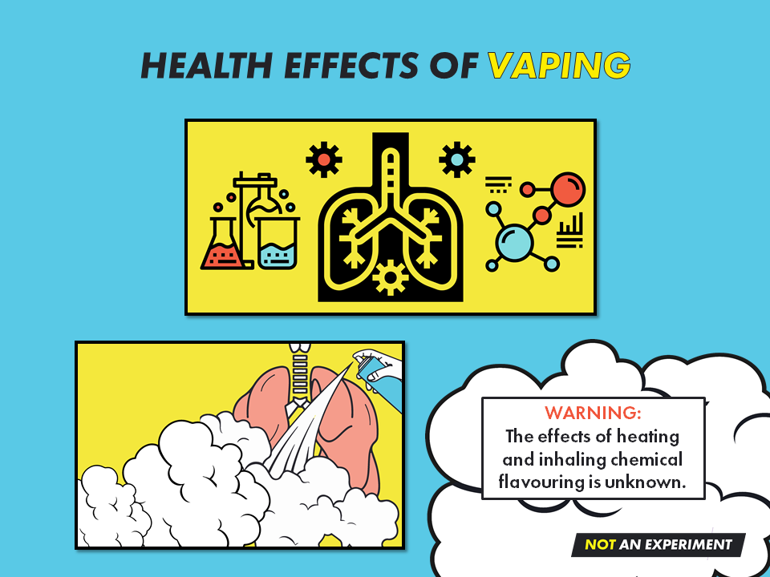
Notes:
Exposure to nicotine and other chemicals in e-cigarettes can damage the lungs. (15)
Lung damage caused by e-cigarettes is similar to damage caused by cigarettes. (16), (17), (18), (19), (20).
The aerosol made by e-cigarettes contains small particles and chemicals, none of which belong in the lungs or body.
Particles in the aerosol can worsen existing lung conditions, making it hard to breath and cause ear, eye and throat irritation (4).
References:
4. Government of Canada. (2019). Consider the consequences of vaping. Retrieved from http://www.canada.ca/en/services/health/campaigns/vaping.html
15. Hamberger, E. S., & Halpern-Felsher, B. (2020). Vaping in adolescents: epidemiology and respiratory harm. Current Opinion in Pediatrics, 32(3), 378-383.
16. Ghosh, A., Coakley, R. D., Ghio, A. J., Muhlebach, M. S., Esther Jr, C. R., Alexis, N. E., & Tarran, R. (2019). Chronic e-cigarette use increases neutrophil elastase and matrix metalloprotease levels in the lung. American journal of respiratory and critical care medicine, 200(11), 1392-1401.
17. Reinikovaite, V., Rodriguez, I. E., Karoor, V., Rau, A., Trinh, B. B., Deleyiannis, F. W., & Taraseviciene-Stewart, L. (2018). The effects of electronic cigarette vapour on the lung: direct comparison to tobacco smoke. European Respiratory Journal, 51(4).
18. Reidel, B., Radicioni, G., Clapp, P. W., Ford, A. A., Abdelwahab, S., Rebuli, M. E., … & Kesimer, M. (2018). E-cigarette use causes a unique innate immune response in the lung, involving increased neutrophilic activation and altered mucin secretion. American journal of respiratory and critical care medicine, 197(4), 492-501.
19. Tanya Lewis. Smoking or Vaping May Increase the Risk of Severe Coronavirus Infection. Scientific American.https://www.scientificamerican.com/article/smoking-orvaping-may-increase-the-risk-of-a-severe-coronavirus-infection1/.Published March 17, 2020. Accessed March 30, 2020.
20. The Ontario Tobacco Research Unit. Are Smokers and Vapers at Higher Risk of COVID19 Infection? https://www.otru.org/wpcontent/uploads/2020/03/otru_covidfaqs_mar2020.pdf. Published March 30, 2020. Accessed April 2, 2020.

Slide 10
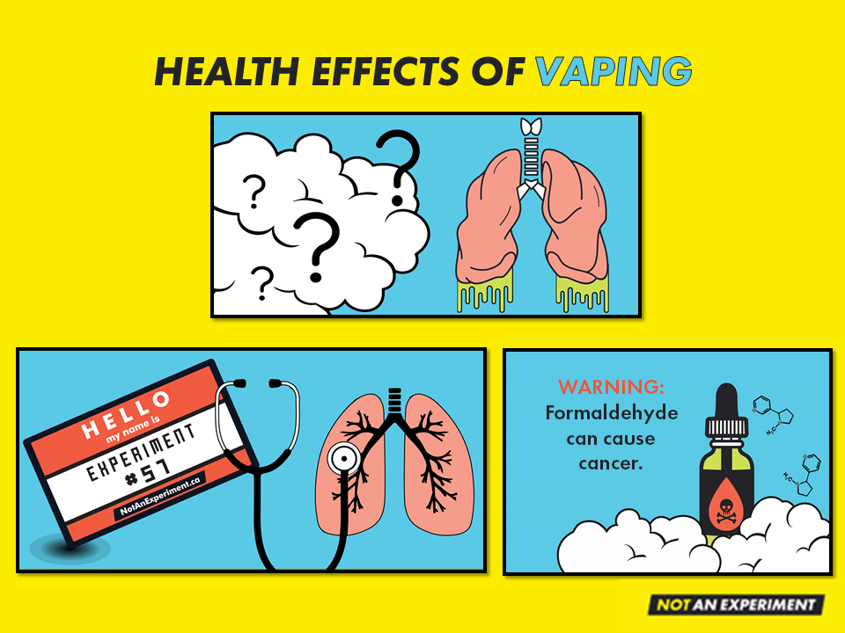
Notes:
Vaping can increase the risk of having a heart attack and using both cigarettes and e-cigarettes increases the risk even more. (3)
When heated, propylene glycol and vegetable glycerin can produce chemicals like formaldehyde, a known carcinogen (to cause cancer). (4)
E-cigarettes can break down over time resulting in heavy metal particles (chromium, nickel, lead) being found in the aerosol. (5)
Among youth in the US, there have been hundreds of reported cases and even deaths from severe lung disease associated with using e-cigarette products. The first Canadian case was reported in Ontario in September 2019.
References:
3. Czoli, C. D., Fong, G. T., Goniewicz, M. L., & Hammond, D. (2018). Biomarkers of exposure among “dual users” of tobacco cigarettes and electronic cigarettes in Canada. Nicotine & Tobacco Research.
4. Government of Canada. (2019). Consider the consequences of vaping. Retrieved from http://www.canada.ca/en/services/health/campaigns/vaping.html
5. Hess, C. A., Olmedo, P., Navas-Acien, A., Goessler, W., Cohen, J. E., & Rule, A. M. (2017). E-cigarettes as a source of toxic and potentially carcinogenic metals. Environmental Research, 152, 221225. https://doi.org/10.1016/j.envres.2016.09.026
15. Hamberger, E. S., & Halpern-Felsher, B. (2020). Vaping in adolescents: epidemiology and respiratory harm. Current Opinion in Pediatrics, 32(3), 378-383.

Slide 11
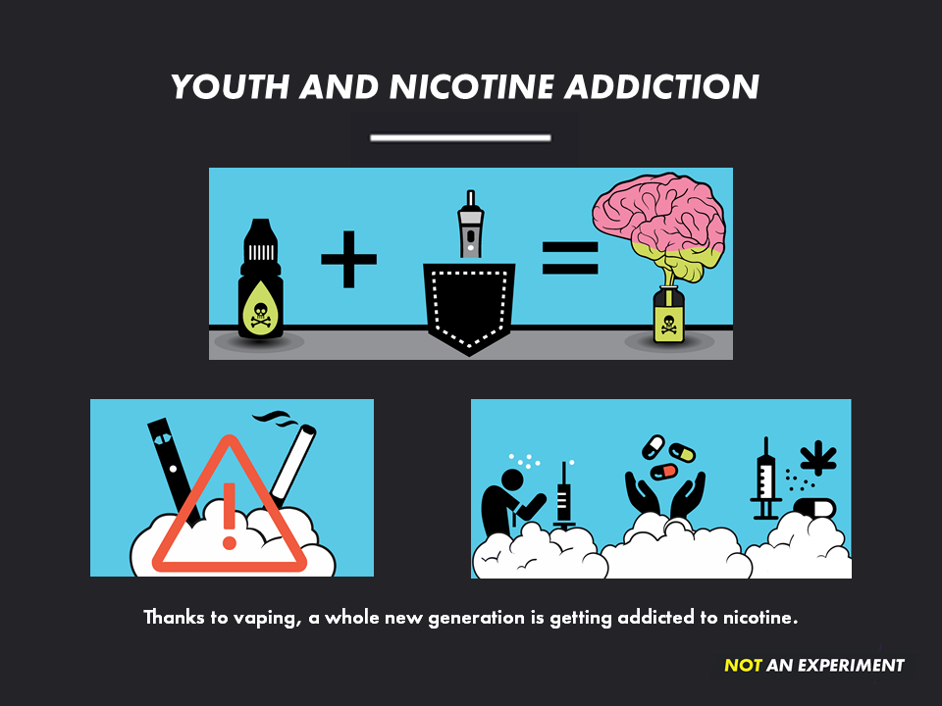
Notes:
Aside from not knowing the long-term health effects of vaping, nicotine addiction is the single biggest concern associated with youth vaping.
The developing teenage brain gets addicted to nicotine faster with less exposure compared to adults. (9)
Addiction to nicotine happens quickly, is powerful, and extremely hard to quit.
Nicotine changes how the teenage brain develops, affecting memory and concentration, reducing impulse control and can sometimes cause behavioural problems. (10)
Youth who vape may be more likely to switch to cigarettes once addicted to nicotine. (11)
Becoming addicted to nicotine at an early age may make youth more likely to develop addictions to other drugs. (8), (12)
References:
8. The National Academies of Science and Engineering. (2018). Public health consequences of e-cigarettes. Retrieved from http://nationalacademies.org/hmd/Reports/2018/public-health-consequences-of-ecigarettes.aspx
9. US Department of Health and Human Services. (2012). Preventing tobacco use among youth and young adults: A report of the Surgeon General.
10. England, L.J., Bunnell, R.E., Pechacek, T.F., Tong, V.T. and McAfee, T.A. (2015). Nicotine and the developing human: A neglected element in the electronic cigarette debate. American Journal of Preventive Medicine, 49(2), pp.286-293.
11. Hammond, D., Reid, J. L., Cole, A. G., & Leatherdale, S. T. (2017). Electronic cigarette use and smoking initiation among youth: a longitudinal cohort study. CMAJ, 189(43), E1328-E1336.
12. US Department of Health and Human Services. (2016). E-cigarette use among youth and young adults: A report of the Surgeon General.

Slide 12
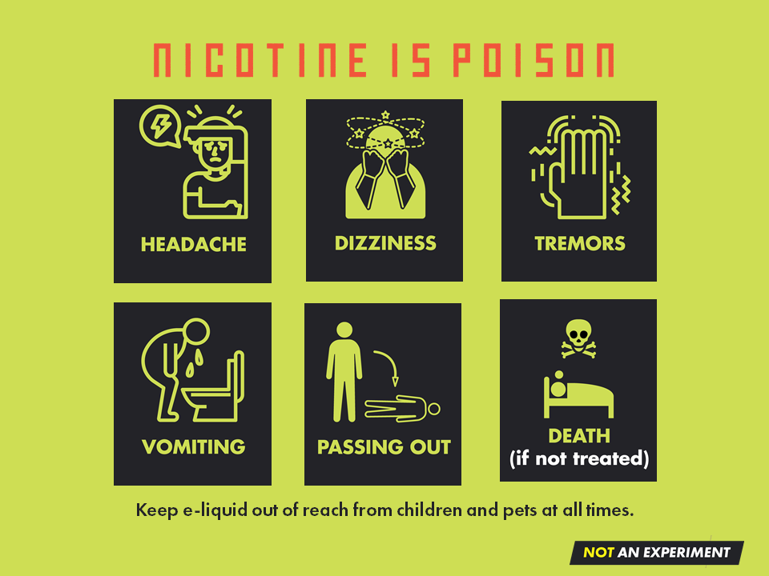
Notes:
Nicotine poisoning is a newer concern that has emerged with youth vaping and not often seen with cigarette smoking.
E-liquid can contain very high levels of nicotine and the design of vape devices lets the user vape quickly and tuck it away making it easy to hide. The combination of high levels of nicotine plus frequent vaping sessions can lead to nicotine poisoning.
Symptoms of nicotine poisoning include: headaches, dizziness, tremors, vomiting, loss of consciousness, and even death if left untreated.
E-liquid has a sweet smell and taste. This in combination with the bright whimsical bottle labels can be very appealing to an unsuspecting child. As a result there have been incidences of children getting nicotine poisoning after drinking e-liquid.
Nicotine absorbed through the skin can also cause an overdose. It is very important that e-liquid is stored in a safe location out of the hands of children.

Slide 13
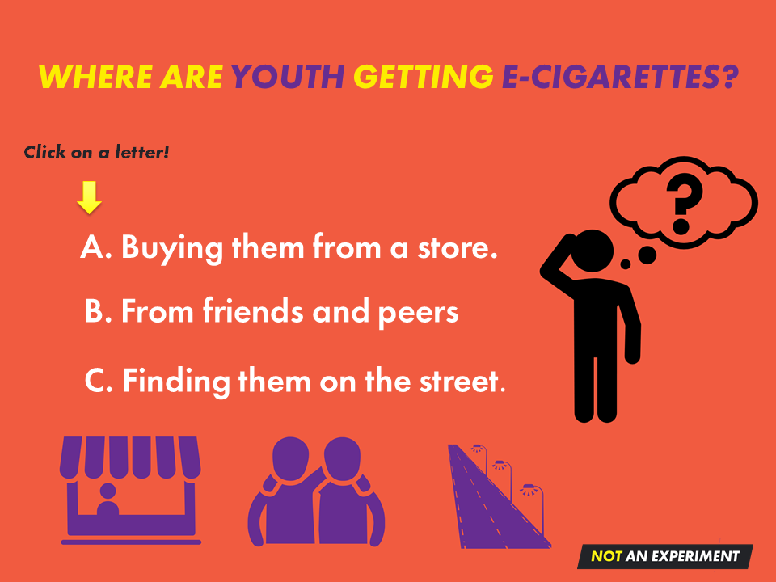
A
B
C
Notes:
Test your knowledge! Click on the answer you think is correct.

Slide 14

Notes:
CLICK try again to go back.

Slide 15
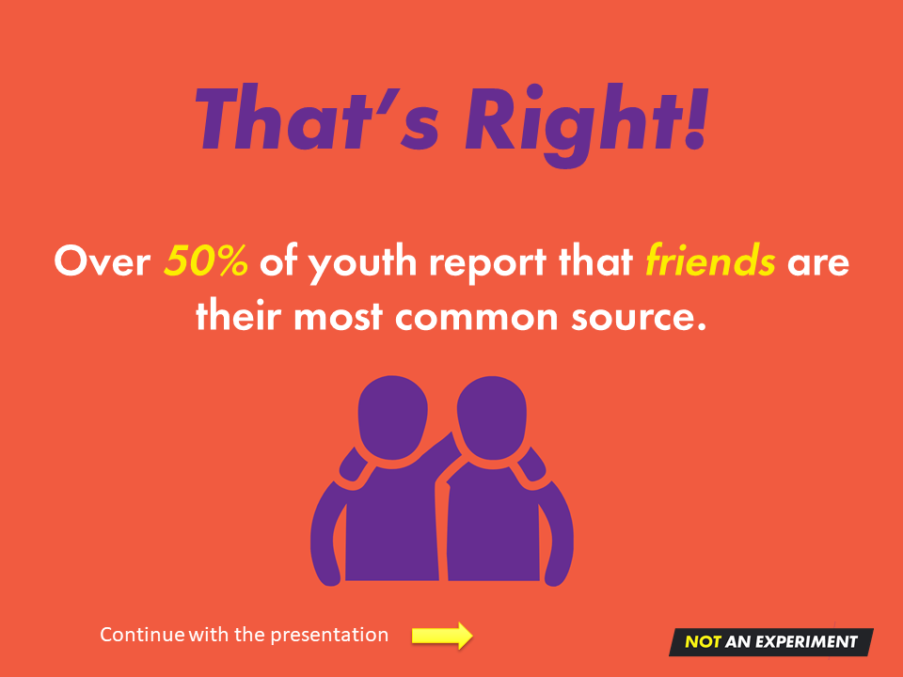
Notes:
Sharing or selling e-cigarettes to your friends is not a good way to be nice. Not only is it against the law, but you are also:
Helping the industry addict people to nicotine.
Helping the industry make money.
Doing the industry’s dirty work for them.

Slide 16
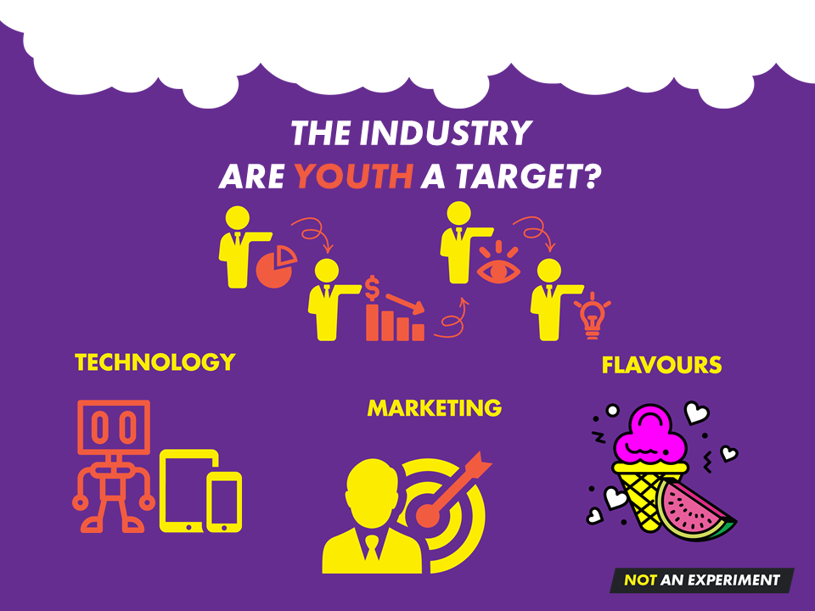
Notes:
Cigarette smoking rates in Canada are the lowest in almost 20 years. (13) This is great news for everyone except the tobacco industry.
The tobacco industry needed to re-invent itself, and e-cigarettes were a perfect product for many reasons:
People love electronic devices.
Removing the need to burn tobacco means vapes can be marketed as a “safer” alternative to cigarettes.
E-liquid comes in 1000s of flavours making them appealing to users of all ages.
Initially, e-cigarettes were not restricted by laws that:
oversee the sales and marketing of cigarettes and
dictate where you can and cannot smoke.
They allow the tobacco industry to keep their profits soaring by – ADDICTING PEOPLE TO NICOTINE.
So even though vapes were originally meant to be a cessation (quit smoking) device, it didn’t take long for the tobacco industry to start buying portions of e-cigarette companies and selling their own brand of e-cigarettes (e.g. Logic and Vype).
Reference:
13. NB Anti-tobacco Coalition. (2019). Canadian Smoking Prevalence Historical Trends, 2001-2019. Retrieved from http://nbatc.ca/2020/08/13/canadian-community-healthsurvey-cchs-results-for-2019-current-smoking-declines-to-14-8-daily-smoking-to-10-0-incanada/

Slide 17
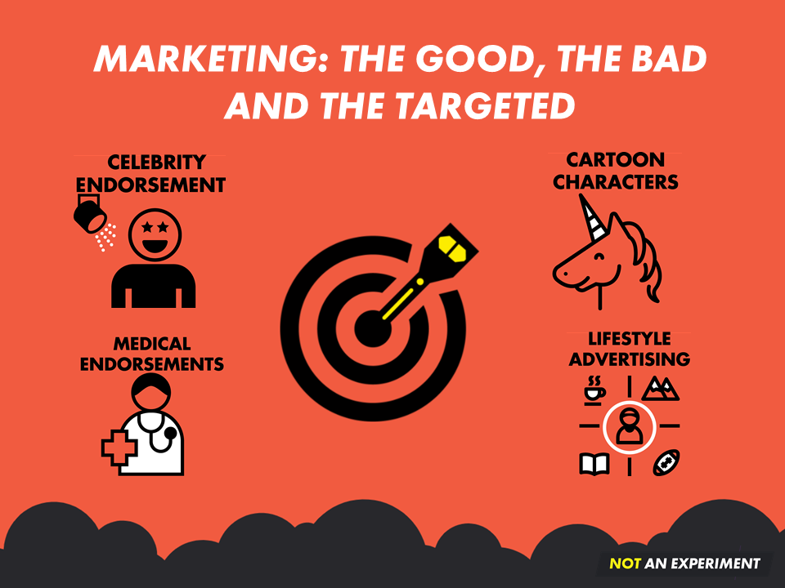

Notes:
Big Tobacco has a well documented history of lying about their products’ addictiveness, health effects and who exactly they’re marketing their products to (youth and other vulnerable people).
They did this by paying billions on questionable marketing techniques:
Celebrity endorsements
Cartoon characters
Flavours
Medical endorsements
Lifestyle Advertising
Product placement and social influencers
Loopholes in the laws
These strategies worked to addict generations of people to commercial tobacco products, especially cigarettes.
Once the partnership between the tobacco industry and the e-cigarette industry was formed, it didn’t take long for e-cigarettes to be marketed using some of the same old tricks perfected by big tobacco.
The bottom line is that the industry pays billions to find ways to market their products. The marketing is designed to make people believe the products are safe, fun, helpful and even a “normal” part of their lives.
It’s important that people - especially young people, are cautious and think critically about what this industry is actually selling us. Behind the flashy labels, fun names, and yummy sounding flavours there exists a darker reality that includes addiction, unknown health risks, and tricks by an industry that is only interested in profits.

Slide 18

Notes:
It is illegal under the Smoke-Free Ontario Act, 2017 to supply tobacco products, e-cigarettes, or e-liquid to anyone under 19 years of age. This includes underage friends sharing products or parents giving products to their kids. It is also illegal to privately sell these products, even to a friend. Breaking these laws could result in fines starting at $365.00.
It is illegal under the Smoke-Free Ontario Act, 2017 to smoke tobacco or vape in public areas within 20m of school property 24 hours a day, 7 days a week. This means a person must be 2 school bus lengths away from the edge of school property before smoking or vaping. Breaking this law could result in a fine of $305.00.

Slide 19

NotAnExperiment.ca
Notes:
Looking to learn more about vaping? Then check out NotAnExperiment.ca!
There you will find:
More information about vaping, the health effects and the industry that makes and sells e-cigarettes.
Ideas on how to generate discussions about vaping including topics that youth could research and debate.
Links to our three NotAnExperiment videos, watch and share!
Escape the Experiment – The Game. This game allows youth in grades 7-12 to learn about vaping in a fun and interactive way. All the pieces needed to play are downloadable from the website, including the game template, a facilitation guide (video and printable copy), answer sheet and a discussion guide.

Slide 20

TAKE ACTION
Notes:
Once you have explored the website and played Escape the Experiment, is it all over? No! Youth are encouraged to take action and continue the conversation with their peers.
NotAnExperiment.ca has a Take Action page with ideas and a Resource page with downloadable materials to help spread the word including:
announcements
postcards for a locker blast
posters
vape and smoke-free pledges

Slide 21
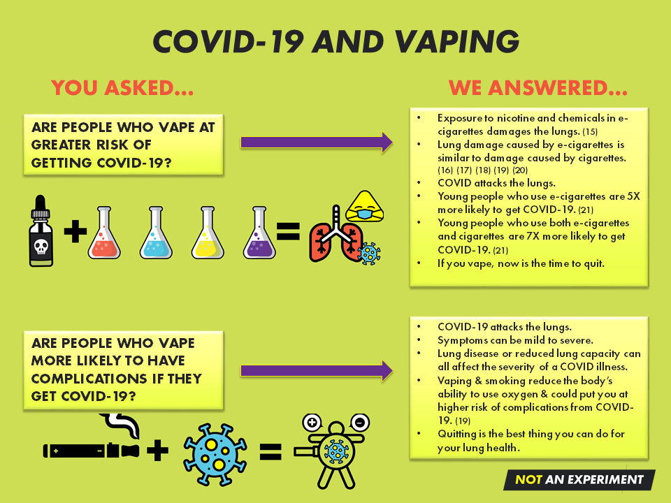
Notes:
NotAnExperiment.ca also answers some common questions related to the COVID-19 virus and vaping, such as:
Are people who vape at greater risk of being exposed to COVID-19? (answer is on the slide)
Are people who vape at greater risk of getting COVID-19?
- Exposure to nicotine and other chemicals in e-cigarettes damages the lungs. (18)
- Lung damage caused by e-cigarettes is similar to damaged caused by cigarettes. (16) (17) (18) (19) (20)
- COVID-19 attacks the lungs.
- Young people who use e-cigarettes are 5X more likely to COVID-19. (21)
- Young people should use both e-cigarettes and cigarettes are 7X more likely to get COVID-19. (21)
- If you vape, now is the time to quit.
3. Are people who vape more likely to have complications if they get COVID-19? (answer is on the slide)
4. Can people get COVID-19 from breathing in secondhand vapour?
Research is only starting to study secondhand vapour and its effects on health.
Not enough is known to understand if COVID-19 can travel in exhaled e-cigarette vapour and infect another person.
Exhaled vapour doesn’t travel far so if COVID is there, the spread into the environment would be small. (22) (23)
If you vape, the time to quit is now.
References:
15. Hamberger, E. S., & Halpern-Felsher, B. (2020). Vaping in adolescents: epidemiology and respiratory harm. Current Opinion in Pediatrics, 32(3), 378-383.
16. Ghosh, A., Coakley, R. D., Ghio, A. J., Muhlebach, M. S., Esther Jr, C. R., Alexis, N. E., & Tarran, R. (2019). Chronic e-cigarette use increases neutrophil elastase and matrix metalloprotease levels in the lung. American journal of respiratory and critical care medicine, 200(11), 1392-1401.
17. Reinikovaite, V., Rodriguez, I. E., Karoor, V., Rau, A., Trinh, B. B., Deleyiannis, F. W., & Taraseviciene-Stewart, L. (2018). The effects of electronic cigarette vapour on the lung: direct comparison to tobacco smoke. European Respiratory Journal, 51(4).
18. Reidel, B., Radicioni, G., Clapp, P. W., Ford, A. A., Abdelwahab, S., Rebuli, M. E., … & Kesimer, M. (2018). E-cigarette use causes a unique innate immune response in the lung, involving increased neutrophilic activation and altered mucin secretion. American journal of respiratory and critical care medicine, 197(4), 492-501.
19. Tanya Lewis. Smoking or Vaping May Increase the Risk of Severe Coronavirus Infection. Scientific American.https://www.scientificamerican.com/article/smoking-orvaping-may-increase-the-risk-of-a-severe-coronavirus-infection1/.Published March 17, 2020. Accessed March 30, 2020.
20. The Ontario Tobacco Research Unit. Are Smokers and Vapers at Higher Risk of COVID19 Infection? https://www.otru.org/wpcontent/uploads/2020/03/otru_covidfaqs_mar2020.pdf. Published March 30, 2020. Accessed April 2, 2020.
21. Gaiha, S. M., Cheng, J., & Halpern-Felsher, B. (2020). Association Between Youth Smoking, Electronic Cigarette Use, and Coronavirus Disease 2019. Journal of Adolescent Health.
22. Sussman, R. and Escrig, C., 2020. Vaping & COVID-19 – Information For Vapers. [online] Consumer Advocates for Smoke-free alternatives Assoc. http://www.casaa.org/news/vaping-covid-19/. Accessed March 27, 2020.
23. The International Society of Substance Use Professionals. Supporting People who Smoke or Vape During the COVID-19Pandemic. https://www.issup.net/events/calendar/2020-04/supporting-people-who-smoke-or-vapeduring-covid-19-pandemic-0.Published April 3, 2020. Accessed April 7, 2020.

Slide 22
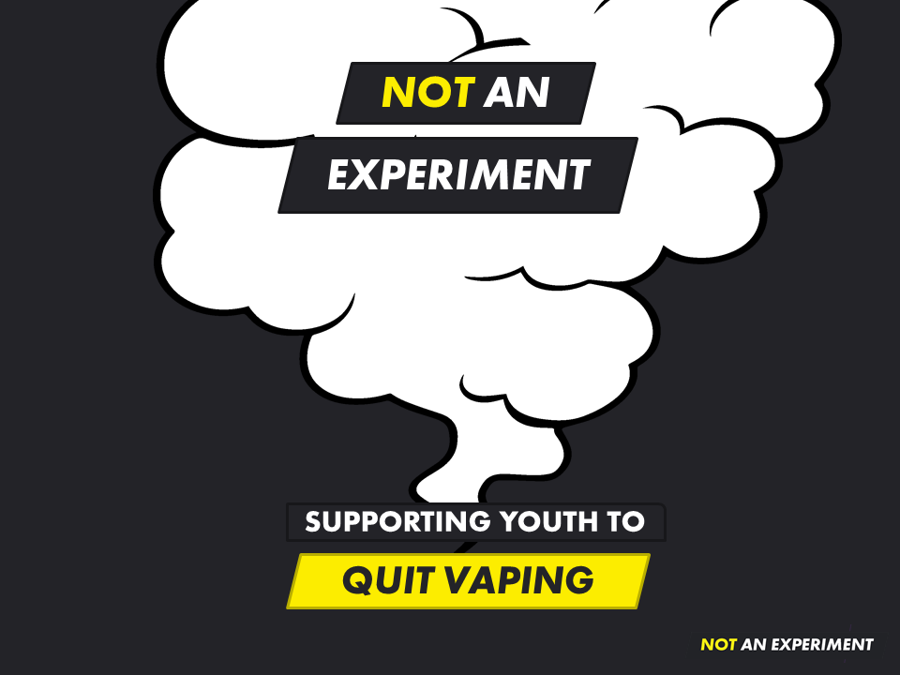
Notes:
While NotAnExperiment.ca primarily focuses on preventing youth vaping, it also contains a cessation resource tool.
The tool walks people through a series of questions to explore their motivation for quitting, has them set a quit date, prepares them for dealing with withdrawal symptoms and identifies where and whom they can turn to for support.
Once complete, the personalized tool is emailed the to user.

Slide 23
