Slide 1
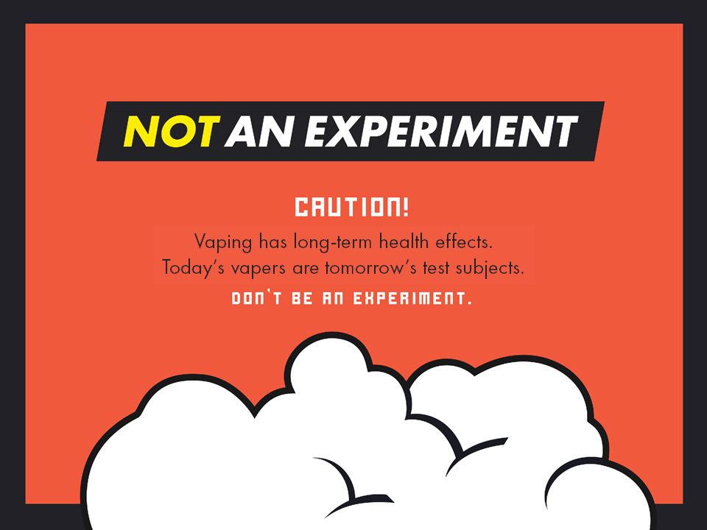
Notes:
Thank you for showing interest in Not An Experiment! This presentation is intended for adults (educators, parents, caregivers etc.) wanting to learn more about vaping and covers topics such as:
What vapes are
The ingredients in e-liquid
Federal and provincial laws that regulate the manufacturing, advertising and sale of the products
Information about the industry that makes and sells the products and how they are target youth
New and emerging tobacco industry products
Health effects & nicotine addiction
How vaping affects mental health
How to talk with young people about vaping
Quit supports
How to use Not An Experiment in a school setting
We do not recommend using this presentation with young people – there are a lot more fun and engaging ways for them to learn! Check out our escape room style games - Escape the Experiment in both an in-person and on-line version along with the other resources available to download for free from the Educator Page.

Slide 2
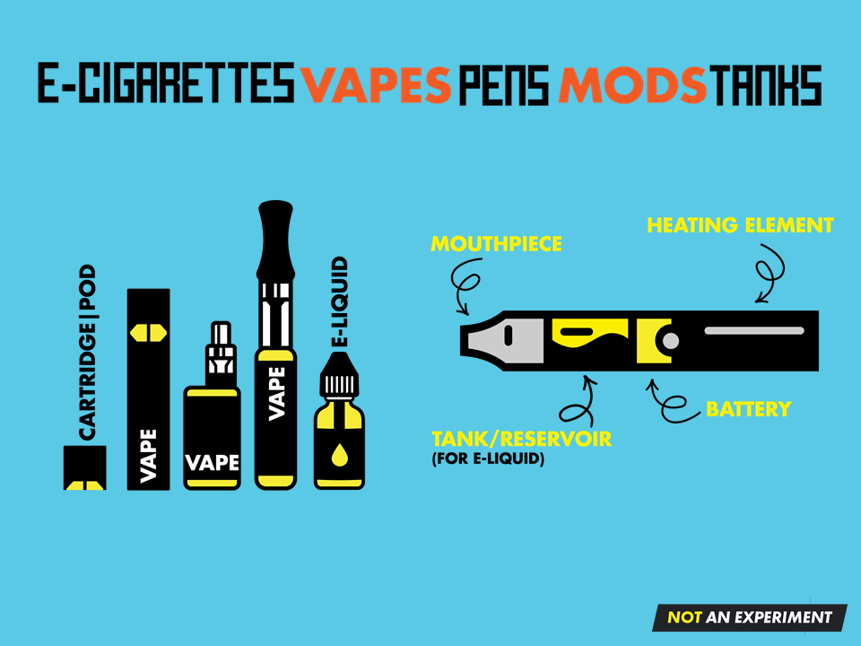
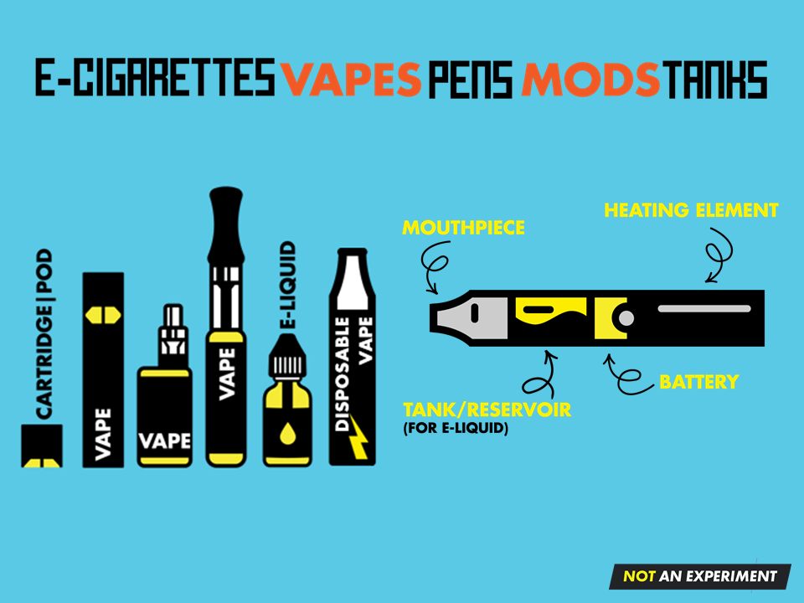
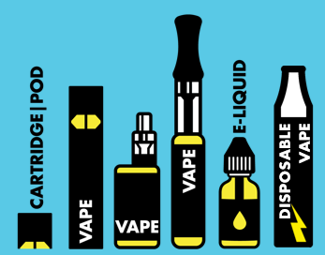
Notes:
Electronic cigarettes are battery operated devices that heat a liquid (e-liquid) until it vapourizes into an aerosol.
They come in many shapes and sizes from box-like devices to small flat sticks that look like USB drives.
All contain the same basic components: a mouthpiece, a tank or cartridge/pod for the vaping liquid, a heating element, and a battery.

Slide 3
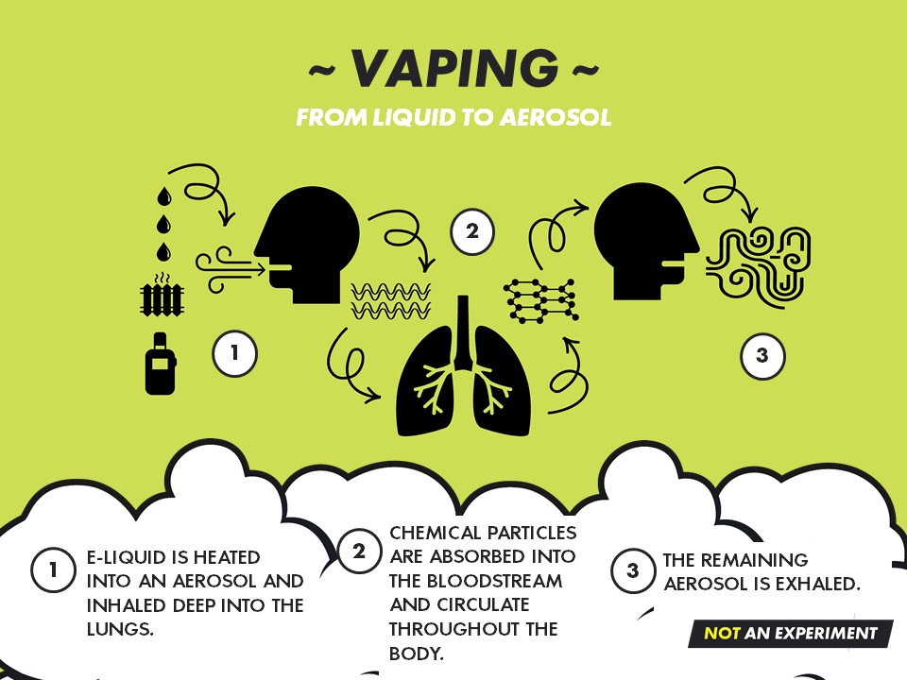
Notes:
Vaping involves inhaling and exhaling an aerosol produced by a vaping device.
The heating element heats e-liquid to the point at which it turns into an aerosol.
The aerosol is not just a harmless water vapour, it is a suspension (mixture) which contains many fine particles.
Once absorbed into the bloodstream, these particles travel to all parts of the body, including the brain.
The remaining aerosol is exhaled back into the air and can appear as white smoke or “cloud”.

Slide 4
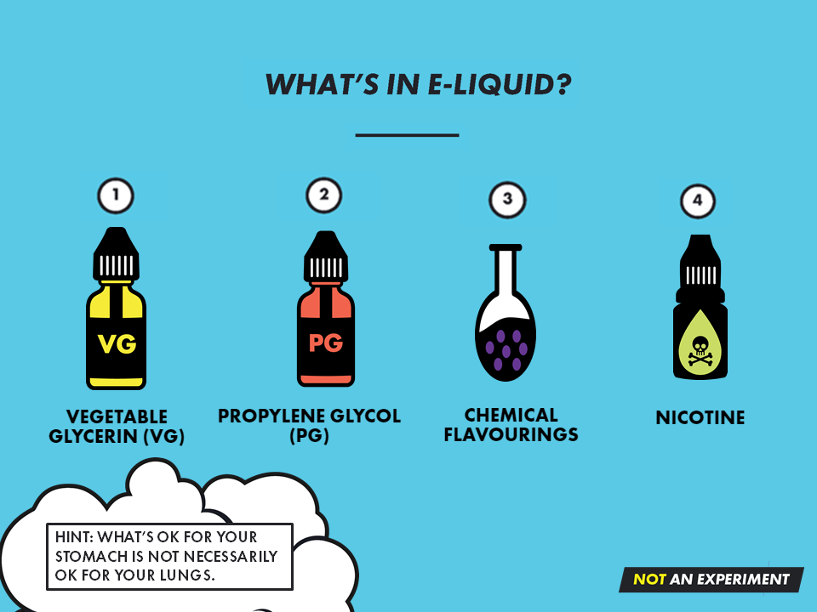
Notes:
There are 4 main ingredients in e-liquid:
Vegetable glycerin (VG) – Syrupy, sweet liquid used to help suspend flavouring and nicotine particles and plays a role in producing the “cloud” that mimics cigarette smoke when a person exhales. It is considered safe to eat in small quantities but has not been proven safe to inhale when vaping.
Propylene glycol (PG) – Colourless, odourless liquid that acts as a preservative and thickener. It plays a role in producing the “cloud” of smoke when a person exhales and helps to carry the flavour particles and nicotine. It is considered safe to eat in small quantities but has not been proven safe to inhale when vaping.
Chemical flavourings – E-liquid comes in thousands of flavours. Despite fancy ads and labels showing pictures of delicious candy and fruit, all e-cigarette flavours are made from chemicals. These chemicals are generally considered safe to eat but have not been proven safe to inhale.
Nicotine – This is the highly addictive drug that keeps users coming back for more. By turning nicotine into a salt, e-cigarette manufacturers found a way to add a lot more of it to e-liquid compared to amounts found in cigarettes.

Slide 5
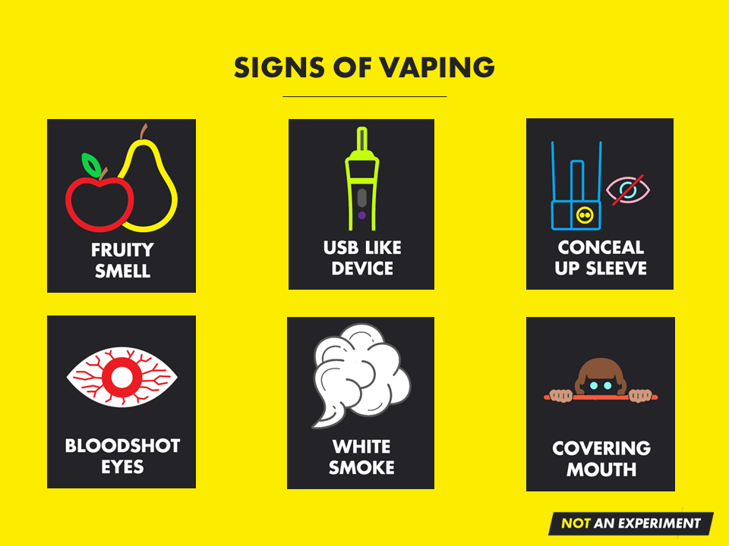

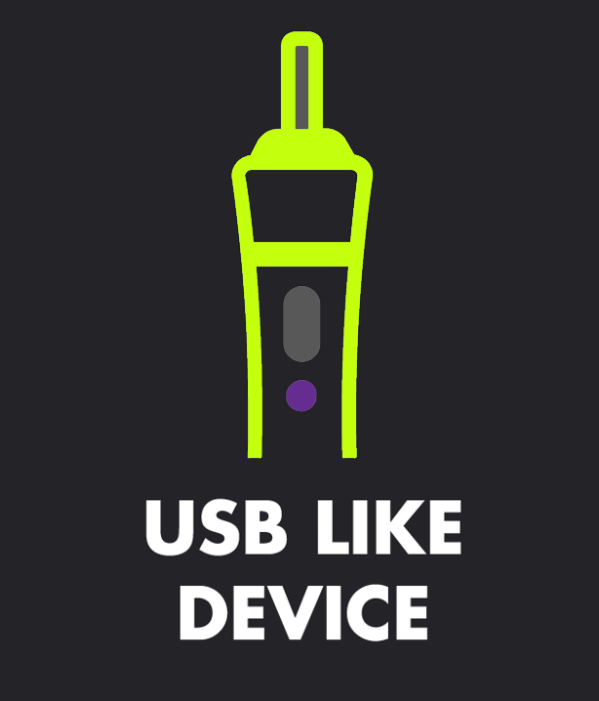

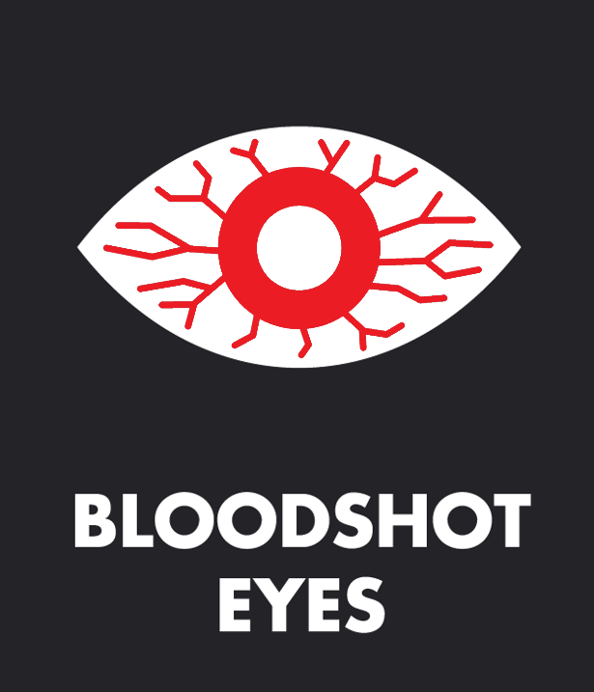




SIGNS OF VAPING
Notes:
Seeing a combination of any of the following may indicate someone is vaping:
Noticing fruity/sweet smells
Noticing unfamiliar USB drives or battery chargers
Appearing to conceal something up a shirt sleeve
Blood shot eyes
Seeing small or large clouds of white aerosol
Raising a shirt up over the face/mouth

Slide 6
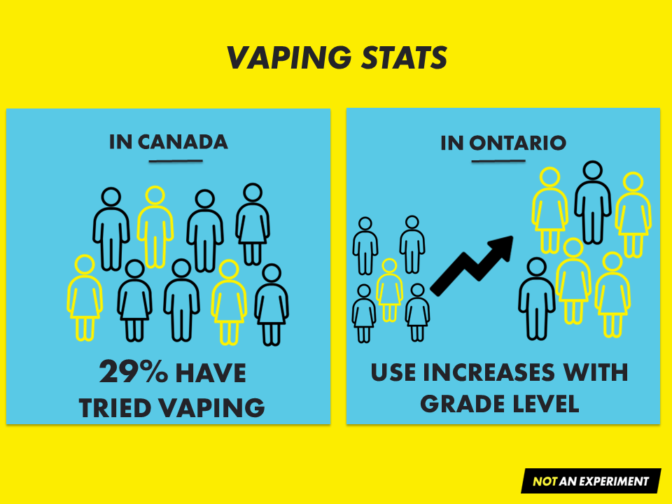



Notes:
Since coming onto the market, e-cigarette use has gained in popularity, especially among non-smokers and youth.
Many people including parents and caregivers believe that vaping is less harmful than smoking cigarettes, and don’t recognize that vaping is not harm free.
According to the 2021-2022 Canadian Student Tobacco, Alcohol and Drugs Survey, Canada has some of the highest teen vaping rates in the world:
29% of high school students have tried vaping.
Nearly 12% of students in grade 10-12, vape daily.⁽¹⁾
In Ontario, rates of past year vaping among youth in grades 7-12 are similar between 2021 and 2023, though some youth, like those in grades 10-12 that identify as female, are more likely to report vaping in the past year.⁽²⁾
Rates of past year vaping also increase with grade, from 5.0% of students in grade 8 to 21.8% of students in grade 12.
Since rates of vaping remain relatively low among students in grades 7 and 8, this time period and extending into early high school, is an important window of opportunity to prevent harms from vaping.
References:
1. Canadian Student Tobacco, Alcohol and Drug Survey (2021-2022). Government of Canada.
2. Boak, A., Hamilton, H. A. (2023). Drug use among Ontario students, 1977-2023: Findings from the Ontario Student Drug Use and Health Survey (OSDUHS). Toronto (ON): Centre for Addiction and Mental Health.

Slide 7
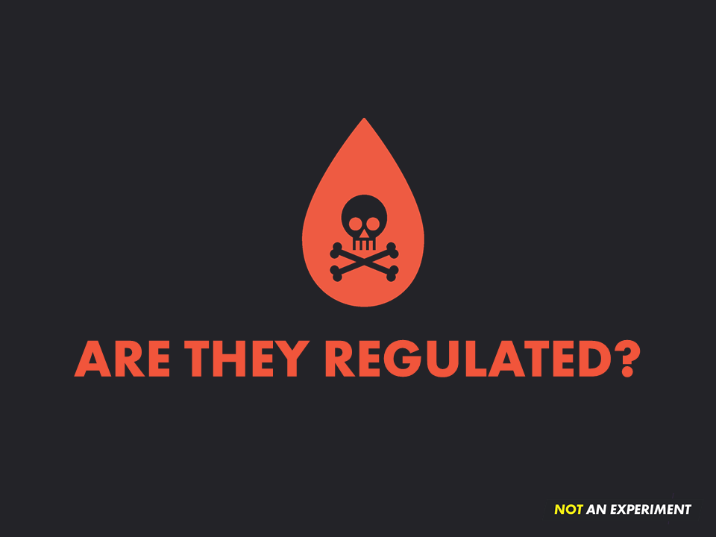
Notes:
E-cigarettes, e-liquid and cartridges/pods became legal to sell in Canada in 2018, at which time the Federal Tobacco and Vaping Products Act was enacted.
It serves to regulate certain aspects of the manufacturing, retailing, labelling and promotion of commercial tobacco products (including vape products) in Canada.
In Ontario, the Smoke Free Ontario Act, 2017 further regulates the use and sale of commercial tobacco and vapour products to protect people, especially youth, from the harms of these products.
Examples of Federal laws:
The advertising or promotion of vaping products can not be done in such a way that it is seen or heard by young people, including online.
Selling vapour products with higher than 20 mg/ml is illegal.
Product labelling requirements including the display of health warnings.
Examples of Ontario Provincial laws:
Flavoured vape products, except for menthol, mint and tobacco flavours, can only be sold in specialty vape shops. No one under the age of 19 is permitted inside a specialty vape shop.
All vape shops must display SFOA, 2017 warning signs.
Specialty vape shops must ensure any indoor product display or promotions are not visible from outside the store.
Non-specialty vape stores (i.e., convenience stores) cannot display vapour products and can only advertise the presence of the products for sale with three signs as set out by provincial regulations.
Despite the laws, these products are still finding their way into the hands of young people.

Slide 8
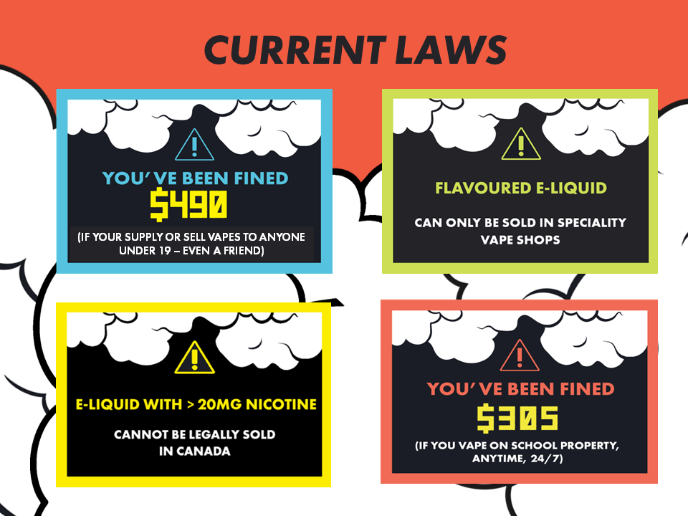
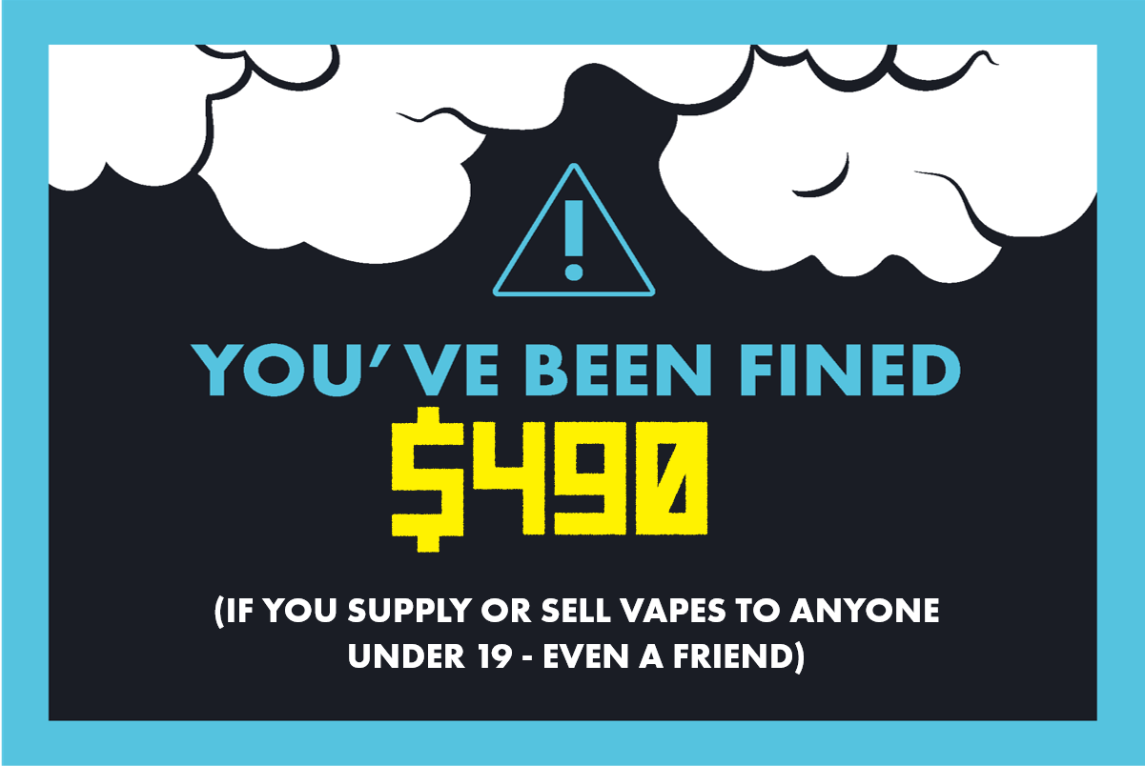


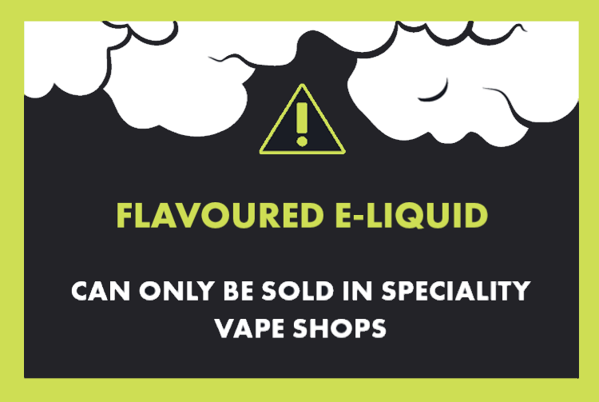

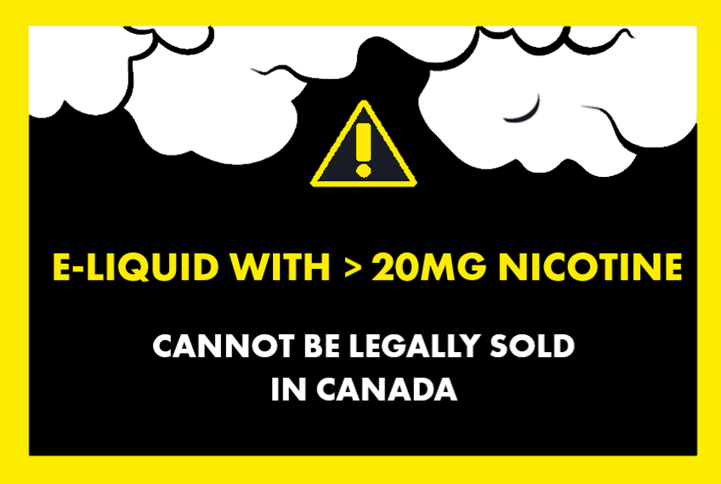
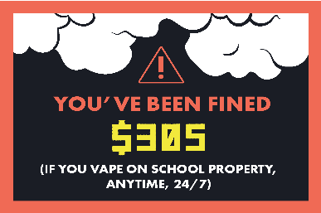
Current Laws
CURRENT LAWS
(IF YOUR SUPPLY OR SELL VAPES TO ANYONE UNDER 19 – EVEN A FRIEND)
Notes:
To further protect community members, and especially youth, from exposure to these products other provincial Smoke-Free Ontario Act, 2017 laws include:
It is illegal to smoke tobacco or vape in public areas within 20m of school property 24 hours a day, 7 days a week. Breaking this law could result in a fine of $305.00.
Under this Act it is also illegal to supply tobacco products, e-cigarettes, or e-liquid to anyone under 19 years of age. This includes underage friends sharing products or parents giving products to their kids. It is also illegal to privately sell these products, even to a friend. Breaking these laws could result in fines starting at $490.00.

Slide 9
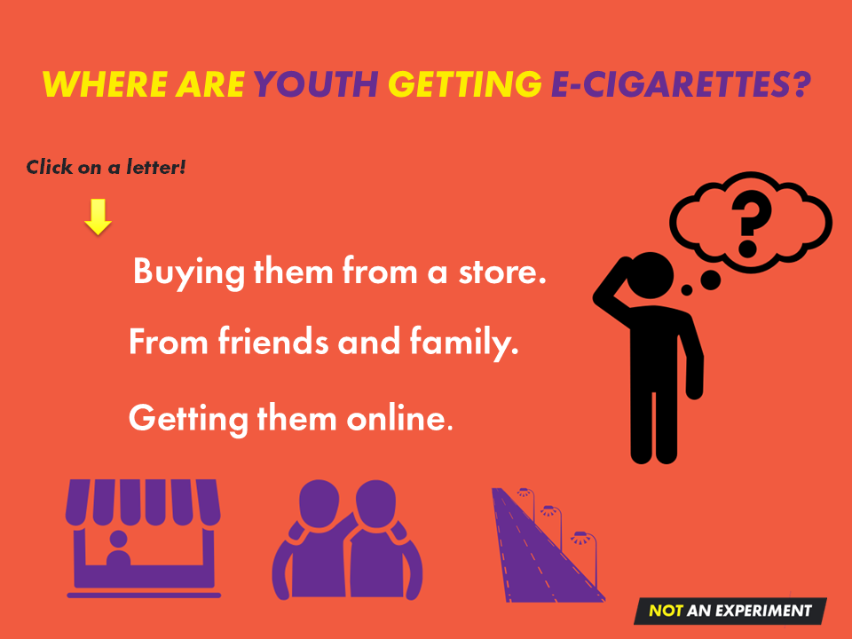



A
B
From social sources.
C
Notes:
Test your knowledge! Click on the answer you think is correct.

Slide 10

Notes:
CLICK try again to go back.

Slide 11
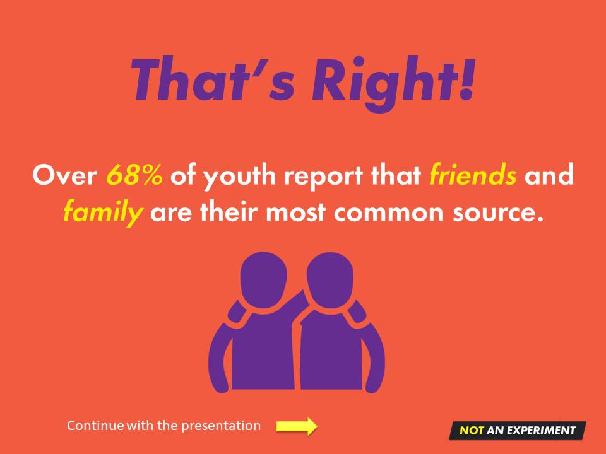
64% of youth who vape got their vapes
from a social source.
Notes:
64% of youth who vaped in the past 12 months got their vapes from social sources (friends, family).⁽¹⁾
This compares to 18% who bought it at a retail store and 4% who gave someone else money to buy it for them.⁽¹⁾
Sharing or selling e-cigarettes to young people is not a good way to be nice. Not only is it against the law, but you are also:
Helping the industry addict people to nicotine.
Helping the industry make money.
Doing the industry’s dirty work for them.
Reference:
Boak, A., Hamilton, H. A. (2023). Drug use among Ontario students, 1977-2023: Findings from the Ontario Student Drug Use and Health Survey (OSDUHS). Toronto (ON): Centre for Addiction and Mental Health.

Slide 12



Preventing a
Whole New Generation
From Nicotine Addiction
Notes:
Why are youth vaping?
Cigarette smoking rates in Canada are the lowest in almost 20 years.⁽¹⁾ This is great news for everyone except the tobacco industry.
The tobacco industry needed to re-invent itself, and e-cigarettes were a perfect product for many reasons:
People, especially youth, love electronic devices.
Removing the need to burn tobacco means vapes can be marketed as a “safer” alternative to cigarettes.
E-liquid comes in 1000s of flavours making them appealing to users of all ages. They make the products appear normal and harmless like candy! Over 90% of youth who vape started with a flavoured vape.⁽²⁾
Initially, e-cigarettes were not restricted by laws that:
oversee the sale and marketing of cigarettes; and
dictate where you can and cannot smoke.
They allow the tobacco industry to keep their profits soaring by ADDICTING PEOPLE TO NICOTINE. The younger the industry can hook people, the more likely they will have a customer for life.
So even though vapes were originally promoted as an alternative to smoking commercial cigarettes, it didn’t take long for the tobacco industry to start buying portions of e-cigarette companies and selling their own brand of e-cigarettes (e.g., Juul, Vuse, Glo, Logic, Vype and Blu).
Reference:
NB Anti-tobacco Coalition. (2019). Canadian Smoking Prevalence Historical Trends, 2001-2019. Retrieved from http://nbatc.ca/2020/08/13/canadian-community-healthsurvey-cchs-results-for-2019-current-smoking-declines-to-14-8-daily-smoking-to-10-0-incanada/
Al-Hamdani, M., Hopkins, D.B. and Davidson, M. The Youth and Young Adult Vaping Project, 2020-2021. The Lung Association, Smoke-Free Nova Scotia and Heart & Stroke.

Slide 13
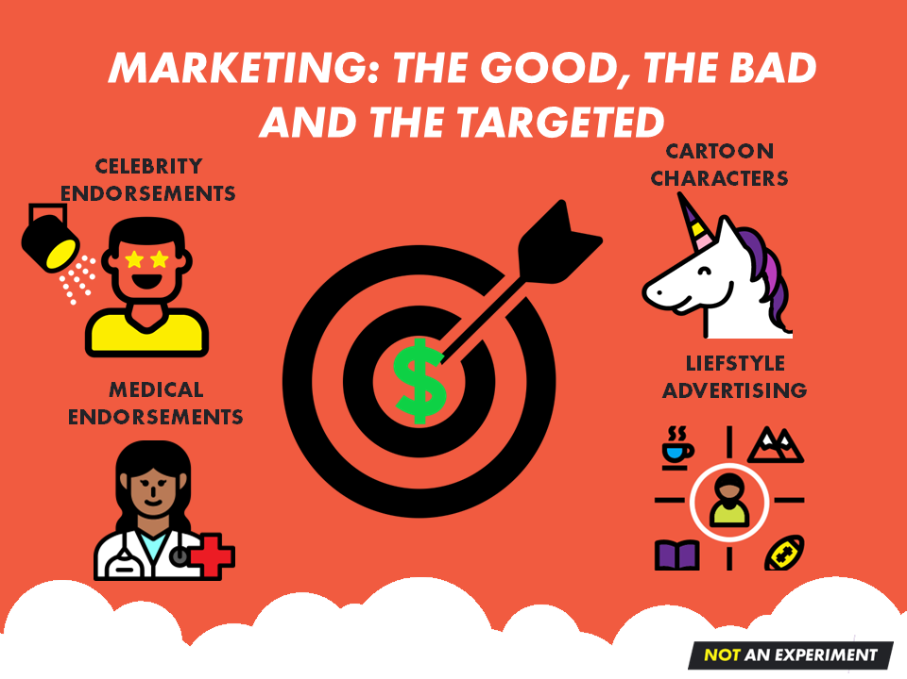









MARKETING: THE GOOD, THE BAD AND THE TARGETED
CARTOON
CHARACTERS
CELEBRITY
ENDORSEMENTS
LIEFSTYLE
ADVERTISING
MEDICAL ENDORSEMENTS
Notes:
Big Tobacco has a well documented history of lying about the addictiveness and health effects of their products as well as who exactly they’re marketing their products to (youth and other vulnerable people).
They do this by paying billions on questionable marketing techniques:
Celebrity endorsements
Cartoon characters
Flavours
Medical endorsements
Lifestyle Advertising
Product placement and social influencers
Loopholes in the laws
These strategies worked to addict generations of people to commercial tobacco products, especially commercial cigarettes.
Once the partnership between the tobacco industry and the e-cigarette industry was formed, it didn’t take long for e-cigarettes to be marketed using some of the same old tricks perfected by big tobacco.
The bottom line is that the industry pays billions to find ways to market their products. The marketing is designed to make people believe the products are safe, fun, helpful and even a “normal” part of their lives.
It’s important that people - especially young people, are cautious and think critically about what this industry is actually selling us. Behind the flashy labels, fun names, and yummy sounding flavours there exists a darker reality that includes addiction, known and unknown health risks, and tricks by an industry that is only interested in profits.

Slide 14
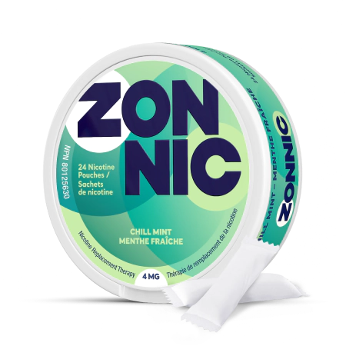
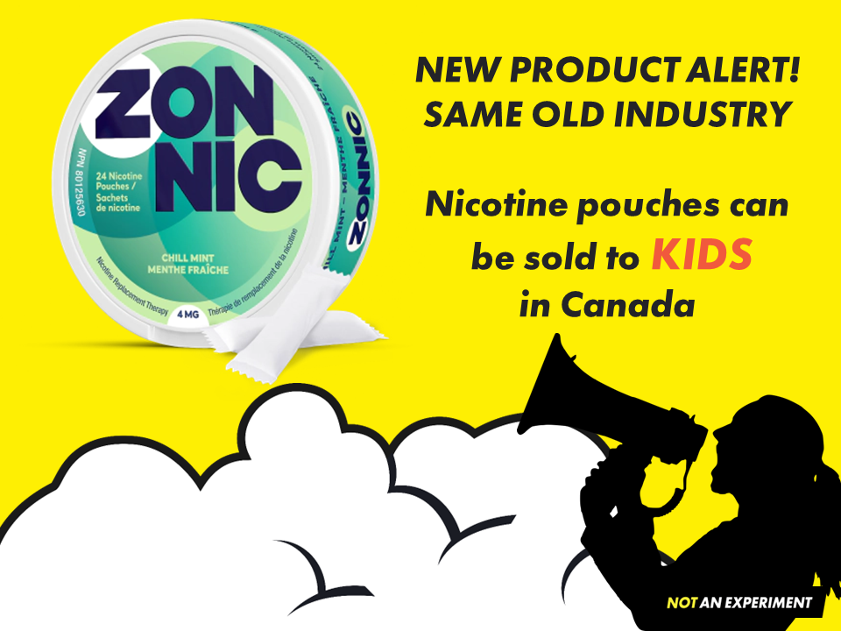



NEW PRODUCT ALERT!
SAME OLD INDUSTRY
Nicotine pouches can
be sold to KIDS
in Canada
Notes:
In July 2023, Health Canada gave approval under the Natural Health Regulations Act for Imperial Tobacco to start selling ZONNIC (flavoured nicotine pouches) as “nicotine replacement therapy”.
By getting approval under the Natural Health Regulation Act, there are no laws to stop the marketing or sale of these tobacco industry products to KIDS.
The pouches are sold in a variety of flavours and brightly coloured containers. Each container has 10 pouches that contain 4mg of nicotine each and add up to the equivalent nicotine of 40 cigarettes or 2 packs.
Other brands such as Zyn are currently illegal to sell in Canada yet are available and contain even higher amounts of nicotine.
This is the first time in OVER 30 years that it is legal to sell nicotine products to children!!

Slide 15
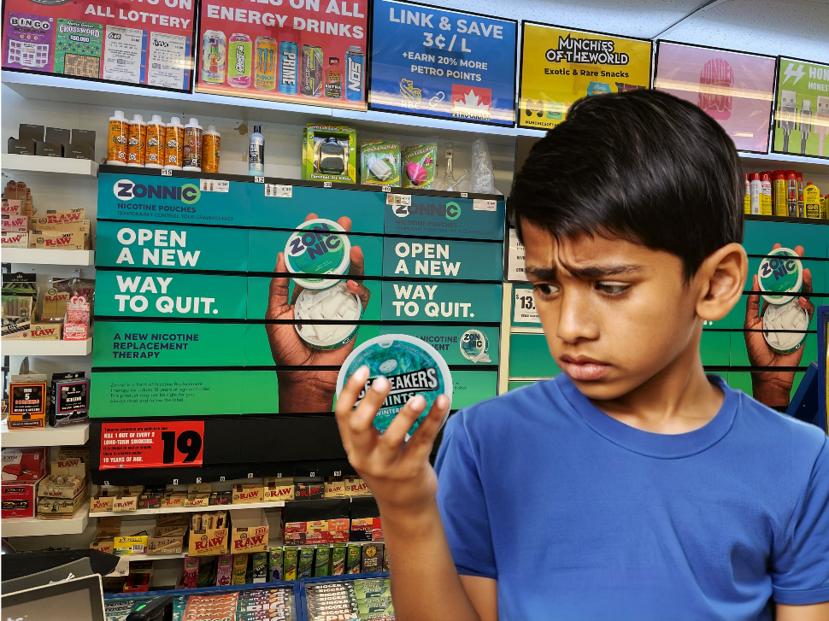
Notes:
Zonnic is widely available in convenience stores and gas stations, often displayed beside candy right at the counter.
Ads for the product can be seen behind the counter on the traditional “Powerwall” where advertisements for cigarettes used to be displayed before advertising laws were passed.
Despite being called a quit smoking aid, the products are marketed in ways that appeal to youth:
Flavours like Tropic Breeze, Chill Mint and Berry Frost
Classic lifestyle advertising, their slogan is “anytime anywhere - pop it, tuck it, and it tingles”
Images used in advertisements imply young healthy people use them in places where smoking and vaping are not allowed
Slang terms for these products include upper deck, upper decky, lip pillow and Zyn.
The tobacco industry is not interested in helping people to stop using their products. They are in the business of attracting new customers (the younger the better), and keeping people addicted to nicotine.

Slide 16
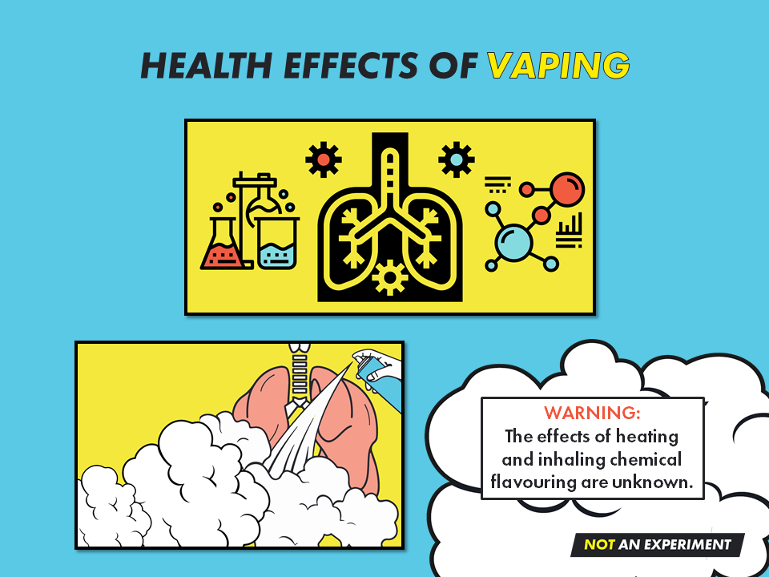

Notes:
The aerosol made by e-cigarettes contains small particles and chemicals, none of which belong in the lungs or body.
E-cigarettes cause damage to the respiratory and circulatory systems.^{(1, 2, 3, 4, 5, 6)}
Vaping can increase respiratory symptoms such as shortness of breath, wheezing, and chest tightness, especially during physical activities. ⁽⁷⁾
Vaping can increase the risk of developing a chronic cough⁽⁸⁾ and symptoms like those caused by asthma.⁽⁹⁾
Particles in the aerosol can worsen existing lung conditions, making it hard to breath and cause ear, eye and throat irritation.⁽¹⁰⁾
Vaping daily or almost daily can lead to dry mouth and discomfort, stained, cracked or broken teeth.⁽⁶⁾
References:
Hamberger, E. S., & Halpern-Felsher, B. (2020). Vaping in adolescents: epidemiology and respiratory harm. Current Opinion in Pediatrics, 32(3), 378-383.
IM Sayed, JA Masso-Silva, A Mittal, A Patel, E Lin, A Moshensky, J Shin, CM Bojanowski… American Journal of Physiology-Lung Cellular and Molecular …, 2021. Journals.Physiology.org
MH Varella, OA Andrade, SM Shaffer, G Castro, P Rodriguez, NC Barengo, JM Acuna Plos one, 2022. Journals.plos.org
W Xie, AP Tackett, JB Berlowitz, AF Harlow, H Kathuria, P Galiatsatos, JL Fetterman, J Cho… American journal of respiratory and critical care medicine, 2022. atsjournals.org
https://smoke-free.ca/science-has-marched-on-its-time-to-update-the-advice-to-canadians/
Stop Vaping Challenge – Staging Website
Mcneill A, Simonavičius E, Brose L, et al. Nicotine Vaping in England: An Evidence Update Including Health Risks and Perceptions, 2022 A Report Commissioned by the Office for Health Improvement and Disparities.; 2022.
Wills TA, Choi K, Pokhrel P, Pagano I. Tests for confounding with cigarette smoking in the association of E-cigarette use with respiratory disorder:
2020 National-Sample Data. Preventive Medicine. 2022;161:107137. doi:10.1016/j.ypmed.2022.107137
Ghosh, A., Coakley, R. D., Ghio, A. J., Muhlebach, M. S., Esther, C. R., Alexis, N. E., & Tarran, R. (2019). Chronic e-cigarette use increases neutrophil
elastase and matrix metalloprotease levels in the lung. American Journal of Respiratory and Critical Care Medicine, 200(11), 1392–1401.
10. Government of Canada. (2019). Consider the consequences of vaping. Retrieved from http://www.canada.ca/en/services/health/campaigns/vaping.html

Slide 17
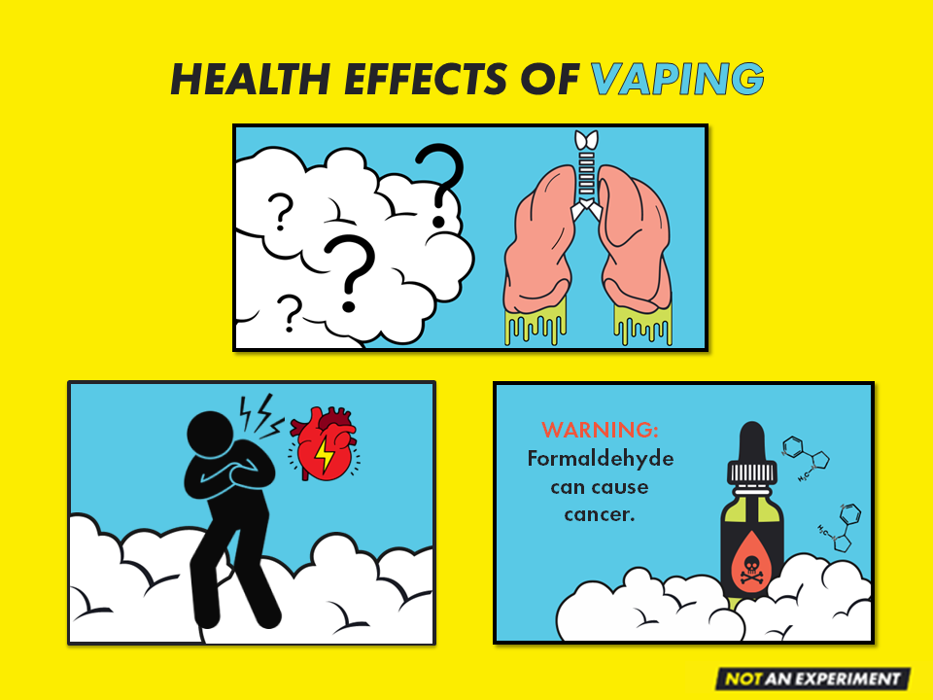
Notes:
Vaping nicotine increases blood pressure. When this happens repeatedly, it can increase the risk of having a heart attack⁽¹⁾ and using both cigarettes and e-cigarettes increases the risk even more.⁽²⁾
When heated, propylene glycol and vegetable glycerin can produce chemicals like formaldehyde, a known carcinogen (to cause cancer).⁽³⁾
E-cigarettes can break down over time resulting in heavy metal particles (chromium, nickel, lead) being found in the aerosol.⁽⁴⁾
References:
Mcneill A, Simonavičius E, Brose L, et al. Nicotine Vaping in England: An Evidence Update Including Health Risks and Perceptions, 2022 A Report Commissioned by the Office for Health Improvement and Disparities.; 2022.
Czoli, C. D., Fong, G. T., Goniewicz, M. L., & Hammond, D. (2018). Biomarkers of exposure among “dual users” of tobacco cigarettes and electronic cigarettes in Canada. Nicotine & Tobacco Research.
Government of Canada. (2019). Consider the consequences of vaping. Retrieved from http://www.canada.ca/en/services/health/campaigns/vaping.html
Hess, C. A., Olmedo, P., Navas-Acien, A., Goessler, W., Cohen, J. E., & Rule, A. M. (2017). E-cigarettes as a source of toxic and potentially carcinogenic metals. Environmental Research, 152, 221225. https://doi.org/10.1016/j.envres.2016.09.026

Slide 18
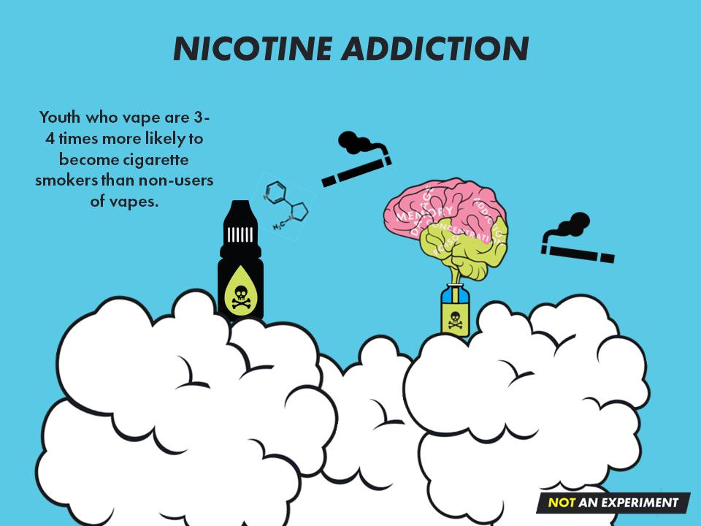


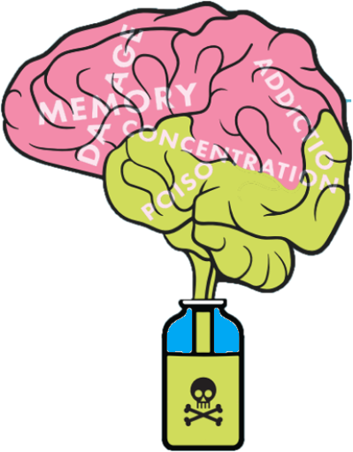





NICOTINE ADDICTION
Youth who vape are 3-4 times more likely to become cigarette smokers than youth who do not vape.
Notes:
Aside from the health effects of vaping, nicotine addiction is the single biggest concern associated with youth vaping.
The developing teenage brain gets addicted to nicotine faster with less exposure compared to adults.⁽¹⁾
Addiction to nicotine happens quickly, is powerful, and makes it extremely hard to quit.
Nicotine changes how the teenage brain develops, affecting memory and concentration, reducing impulse control, and can sometimes cause behavioural problems.⁽²⁾
Youth who vape are 3-4 times more likely to switch to cigarettes once addicted to nicotine.⁽³⁾
Becoming addicted to nicotine at an early age may make youth more likely to develop addictions to other drugs.^{(4, 5)}
References:
US Department of Health and Human Services. (2012). Preventing tobacco use among youth and young adults: A report of the Surgeon General.
England, L.J., Bunnell, R.E., Pechacek, T.F., Tong, V.T. and McAfee, T.A. (2015). Nicotine and the developing human: A neglected element in the electronic cigarette debate. American Journal of Preventive Medicine, 49(2), pp.286-293.
Hammond, D., Reid, J. L., Cole, A. G., & Leatherdale, S. T. (2017). Electronic cigarette use and smoking initiation among youth: a longitudinal cohort study. CMAJ, 189(43), E1328-E1336.
The National Academies of Science and Engineering. (2018). Public health consequences of e-cigarettes. Retrieved from http://nationalacademies.org/hmd/Reports/2018/public-health-consequences-of-ecigarettes.aspx
US Department of Health and Human Services. (2016). E-cigarette use among youth and young adults: A report of the Surgeon General.

Slide 19


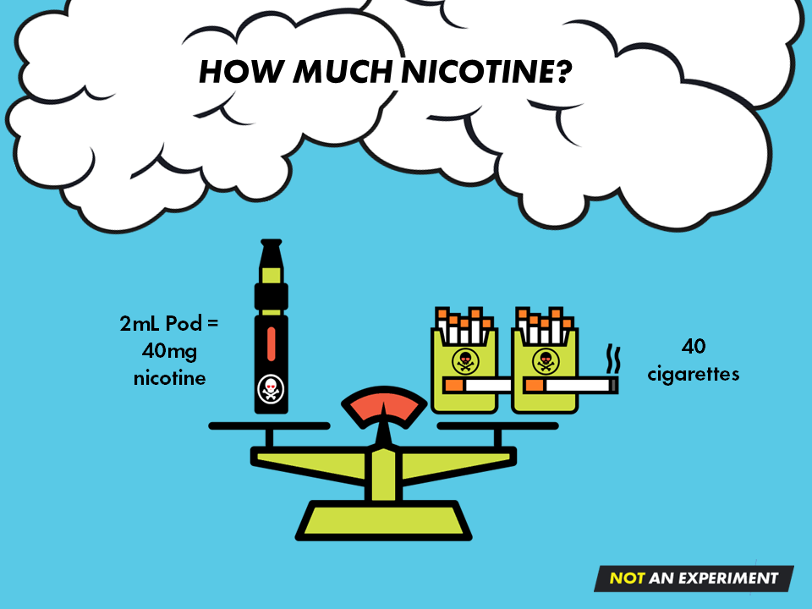
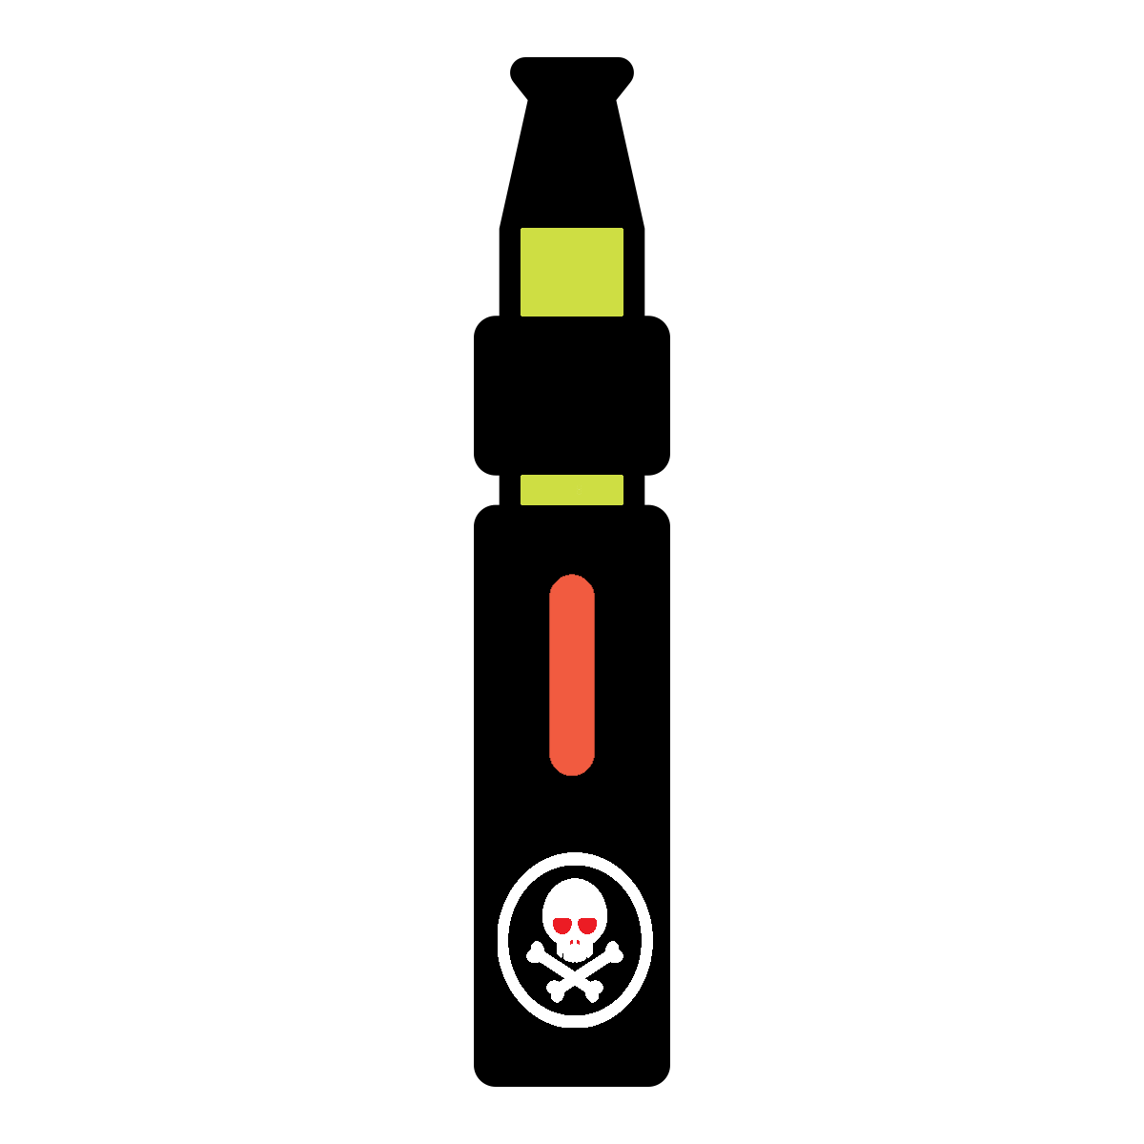
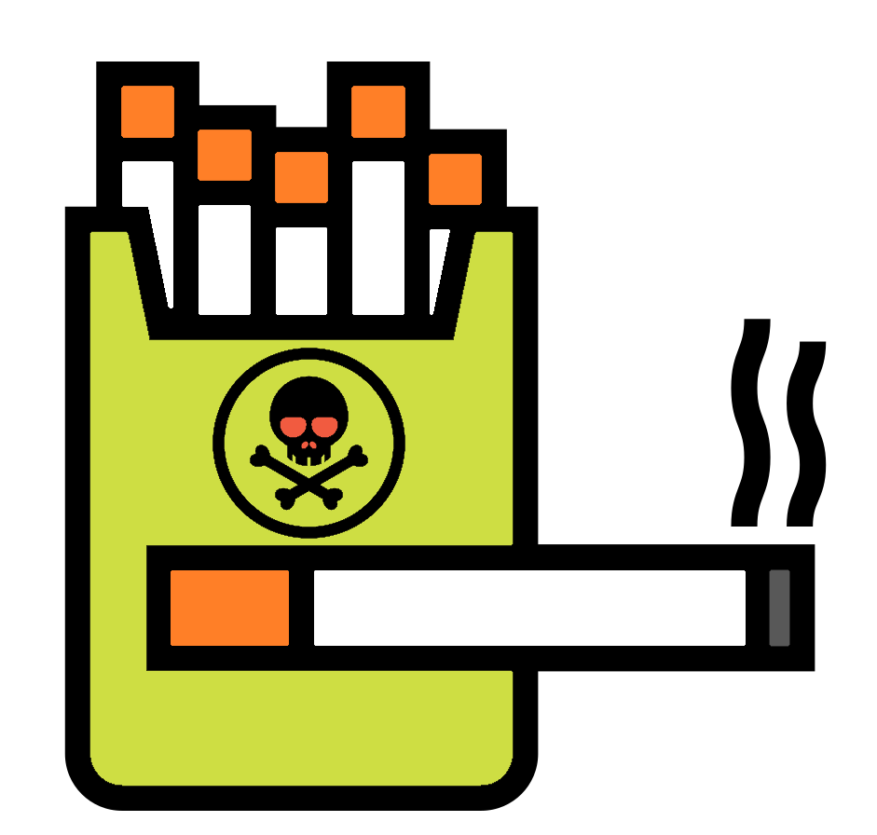

HOW MUCH NICOTINE?
2mL Pod =
40mg
nicotine
40
cigarettes
Notes:
Legally in Canada, the highest concentration of nicotine an e-cigarette can have is 20mg/mL.
A typical vape pod holds 2mL of e-liquid so that is equivalent to about 40 cigarettes or two packs.
Many products that have the legal amount of nicotine, have tanks that can hold larger volumes of e-liquid, and because of this, these devices can contain as much nicotine as 320 traditional cigarettes.
We also still see a lot of vapes that contain illegal amounts of nicotine, upwards of 50 mg/ml in some cases, and when that is used in a device with a larger tank, it could contain as much nicotine as 500 cigarettes.

Slide 20
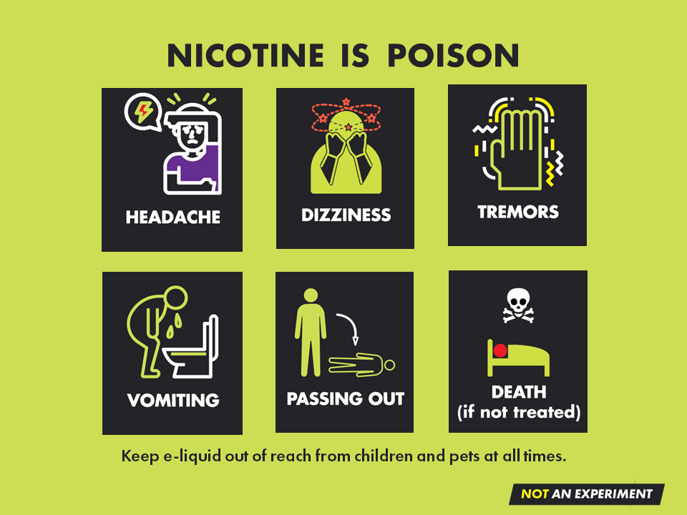
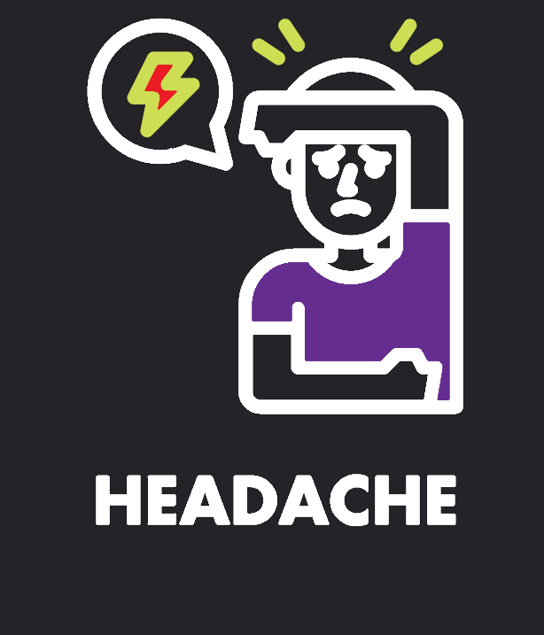
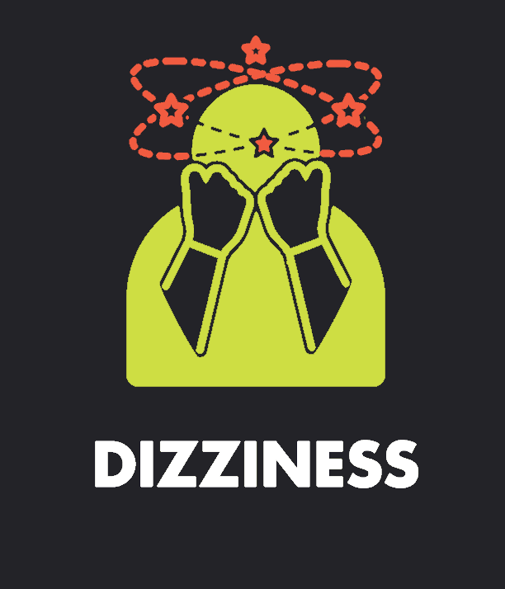

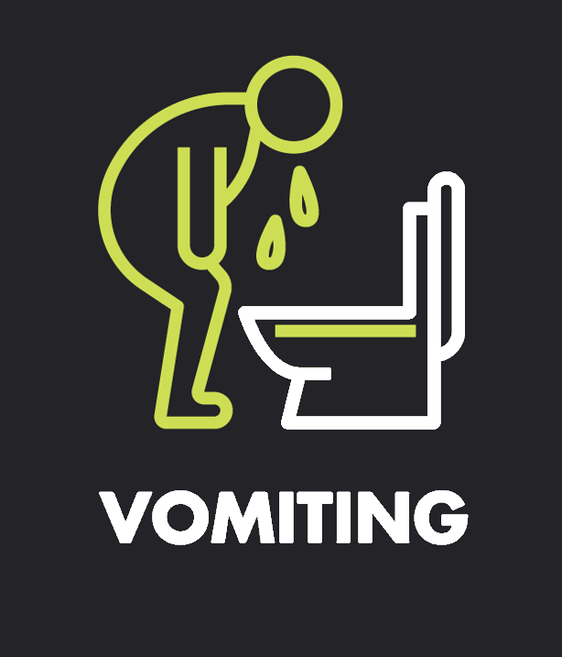

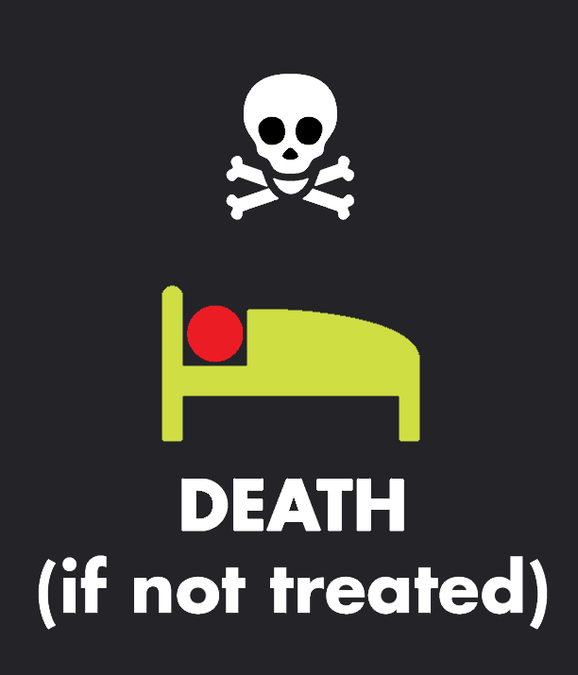
NICOTINE IS POISON
Keep e-liquid out of reach from children and pets at all times.
Notes:
Nicotine poisoning is a concern that has emerged with youth vaping although it is not often seen with cigarette smoking.
E-liquid can contain very high levels of nicotine and the design of vape devices allows for youth to vape quickly and often. This results in consuming large amounts of nicotine without even realizing it. The combination of high levels of nicotine plus frequent vaping sessions can lead to nicotine poisoning.
Symptoms of nicotine poisoning include headaches, dizziness, tremors, vomiting, loss of consciousness, and even death if left untreated.
E-liquid has a sweet smell and taste and in combination with the bright whimsical bottle labels can be very appealing to an unsuspecting child. As a result, there have been incidents of children getting nicotine poisoning after drinking e-liquid.
Nicotine absorbed through the skin can also cause an overdose. It is very important that e-liquid is stored in a safe location out of the reach and hands of children.

Slide 21
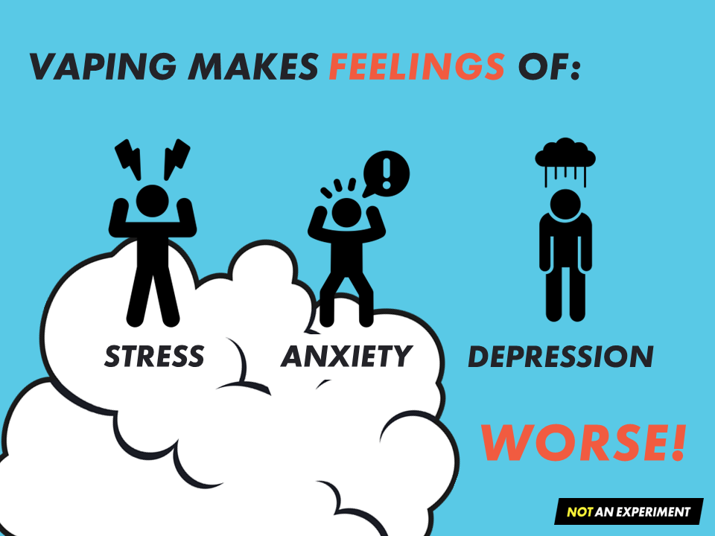




VAPING MAKES FEELINGS OF
STRESS
ANXIETY
DEPRESSION
WORSE
Notes:
People may think vaping helps get rid of stress, anxiety, and depression – but it doesn’t, in fact, it can make symptoms worse.^{(1, 2, 3)}
Vaping delivers nicotine to the brain. Nicotine is a drug, and once the brain gets addicted, a person will experience uncomfortable withdrawal symptoms whenever nicotine isn’t present.
Withdrawal symptoms are stressful, anxiety provoking and cause people to feel down.
Vaping nicotine can get rid of these feelings almost immediately, so it becomes associated with providing relief from uncomfortable mental health symptoms. However, all it really does is stop nicotine withdrawal and provide temporary relief. Withdrawal symptoms will return if nicotine continues to be used.
References:
1.Lechner WV, Janssen T, Kahler CW, et al. Bi-directional associations of electronic and combustible cigarette use onset patterns with depressive symptoms in adolescents. Preventive Medicine 2017;96:73-78.
https://www.thetruth.com/the-facts/fact-vaping-nicotine-and-stress
Kutlu MG, Gould TJ. Nicotine modulation of fear memories and anxiety: Implications for learning and anxiety disorders. Biochemical Published Online First: 2015/08/02.

Slide 22
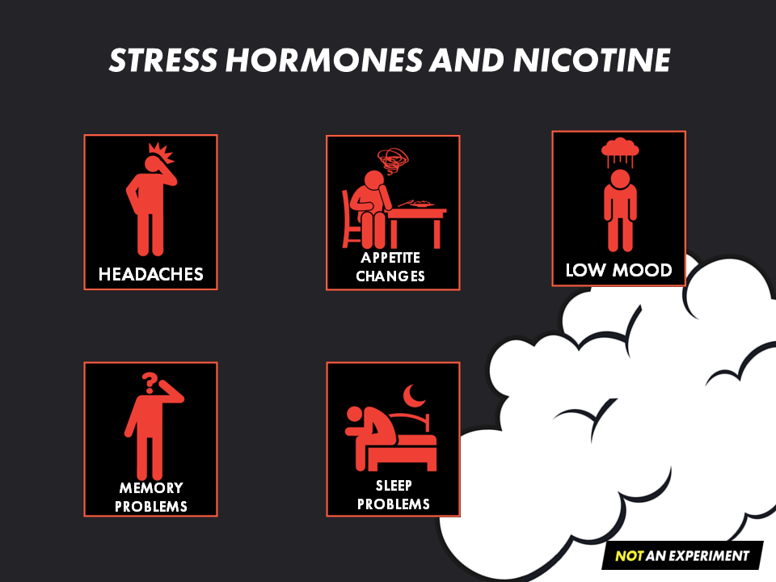

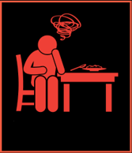




STRESS HORMONES AND NICOTINE
APPETITE
CHANGES
LOW MOOD
HEADACHES
MEMORY
PROBLEMS
SLEEP
PROBLEMS
Notes:
In addition, nicotine also causes the body to release adrenaline and cortisol – the same hormones released when someone is stressed.
So, each time a person vapes, their body responds like it does when they are stressed or anxious.
The effects of stress hormones for a short period of time are okay, but if these hormones are released every time a person vapes (several times a day, several times an hour), the same health problems that come from unmanaged stress can happen to someone who vapes. These include:
Depression or low mood
Headaches
Problems with falling asleep and/or staying asleep
Changes in appetite
Problems with memory and concentration⁽¹⁾
Reference:
Mayo Clinic (2021, August 8). Stress Management. https://www.mayoclinic.org/healthy-lifestyle/stress-management/in-depth/stress/art-20046037

Slide 23
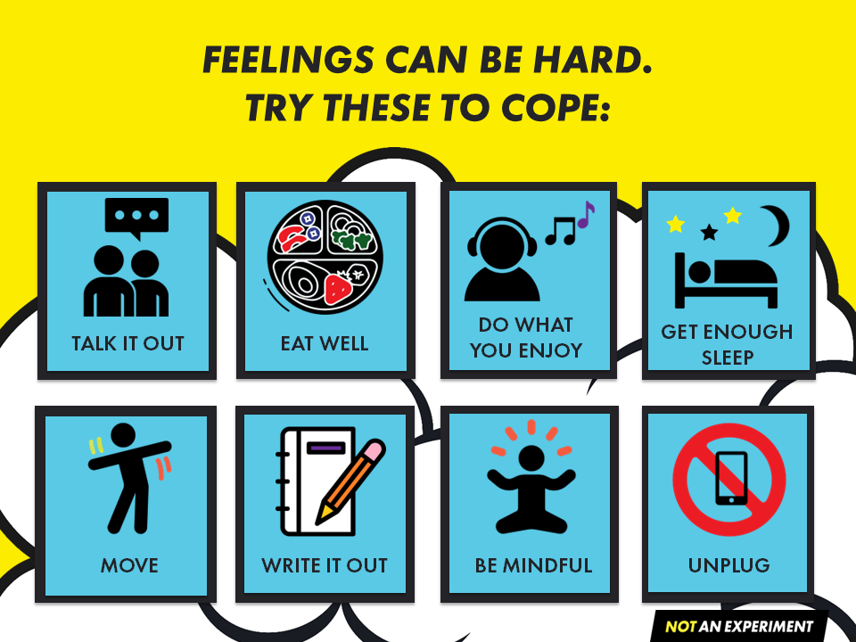


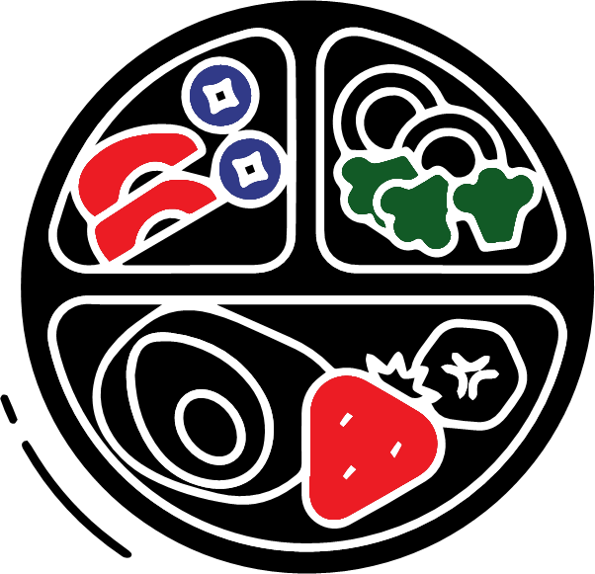











FEELINGS CAN BE HARD.
TRY THESE TO COPE:
DO WHAT YOU ENJOY
GET ENOUGH SLEEP
TALK IT OUT
EAT WELL
MOVE
WRITE IT OUT
BE MINDFUL
UNPLUG
Notes:
When speaking with youth, it’s important to emphasize that vaping is not a productive way to cope with stress, anxiety or depression.
Provide suggestions on other things to try such as:
Talking to someone
Eating a variety of foods
Listening to music
Finding joy in movement
Journaling
Practicing mindfulness
Getting enough sleep
Unplugging from screens

Slide 24
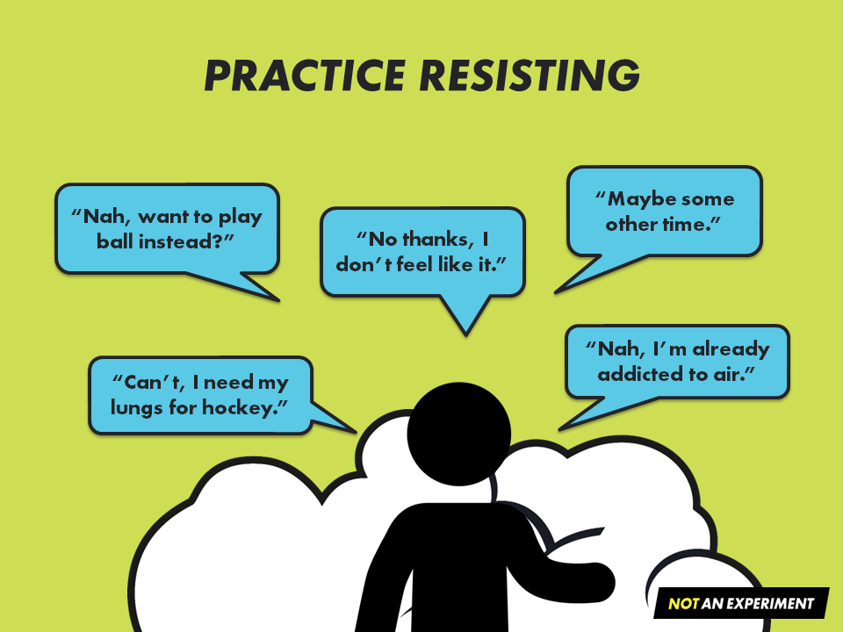


PRACTICE RESISTING
“Maybe some other time.”
“Nah, want to play ball instead?”
“No thanks, I don’t feel like it.”
“Nah, I’m already addicted to air.”
“Can’t, I need my lungs for hockey.”
Notes:
Youth may be exposed to vaping regularly – on social media, television and movies, and socially with friends and peers. This exposure can contribute to them feeling pressured to try vaping.
Caring adults can give youth options of what to say as well as opportunities to practice their responses should they be asked to try vaping.
This will help to ensure they have the confidence to respond in a way that is true to them.
Strategies to practice could include:
Flat out refusing
Delaying an answer
Suggesting a different activity
Making a joke
Asking questions
Walking away
Visit NotAnExperiment.ca/resist for more information.

Slide 25

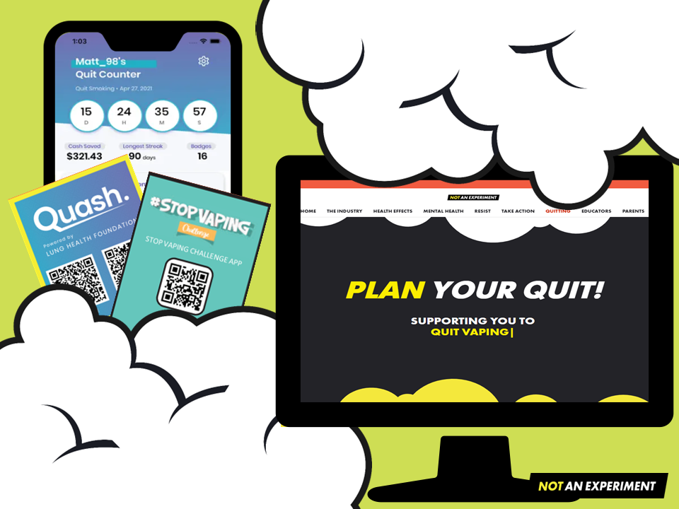

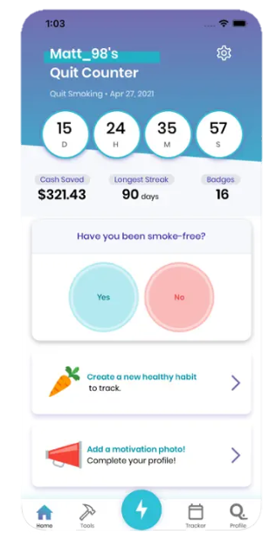

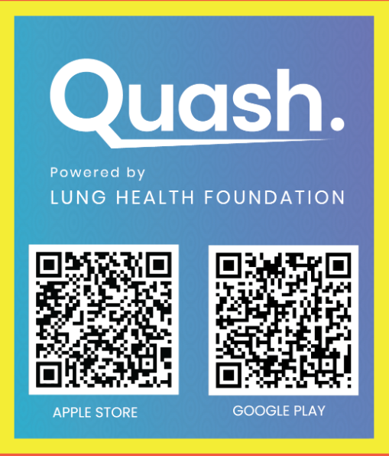
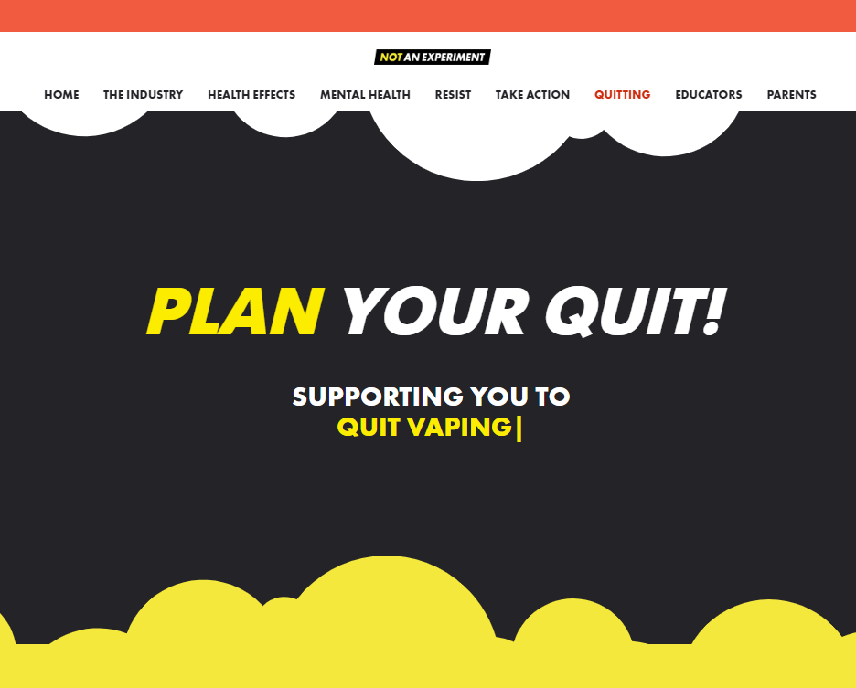
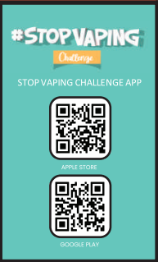

Notes:
Resources are available to help young people quit vaping:
The Notanexeperiment.ca “Quitting” page offers a downloadable quit plan to help youth plan and prepare to quit by reflecting on their own vaping experience and determining how they will deal with their triggers when making a quit attempt.
Two free apps – Quash and Stop Vaping Challenge (links available at NotAnExperiment.ca/quitting) provide tools, tracking and feedback to encourage quitting in tech savvy ways that appeal to youth.
Advise a young person to speak to their family doctor, nurse practitioner or another accessible health care provider.

Slide 26
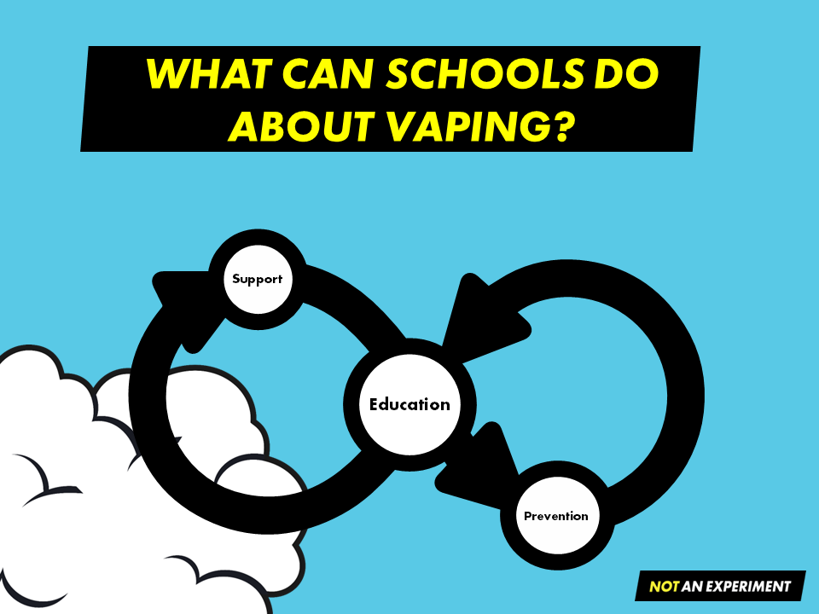

WHAT CAN SCHOOLS DO ABOUT VAPING?
Suppo
rt
Education
Prevention
Notes:
Youth vaping is a complex issue. Education and raising awareness are the first steps to ensure young people can sort out misinformation from facts, allowing them to make informed choices.
Use of a comprehensive approach to education, ensures that youth, educators, parents, and caregivers are exposed to the messaging many times, in many ways. This, increases the likelihood that people will understand and remember the information.
The Not An Experiment program offers several resources that schools can use to deliver messaging and education about vaping to students, teachers, parents and caregivers.

Slide 27

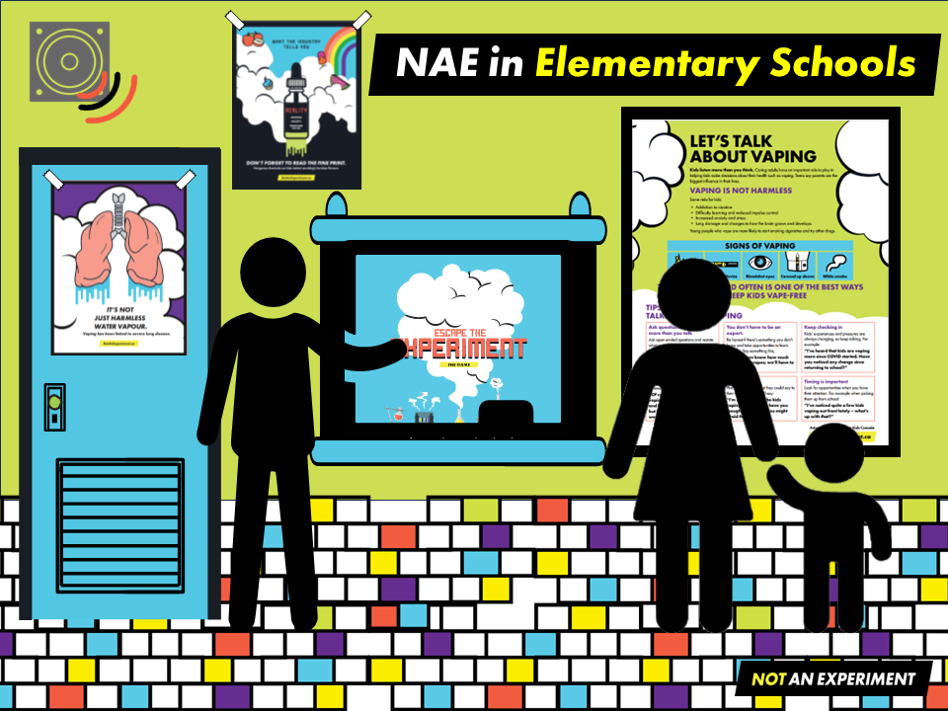
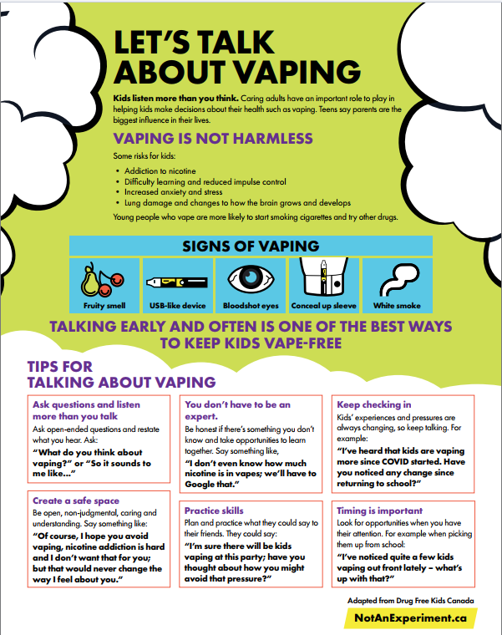



NAE in Elementary Schools
Notes:
Not An Experiment in an elementary school setting:
School administrators and educators can learn about vaping and the resources available by exploring the NotAnExperiment.ca website.
Schools can use and implement the various resources available at NotAnExperiment.ca/educators. Check with your local public health unit to see what types of support they have available.
To educate students:
Hang posters around the school.
Have the announcements read daily.
Have grade 7 & 8 teachers use the lesson plans and corresponding Escape the Experiment Game with their students.
Use the Refusal Skills resource to allow students to practice what they can say if ever asked to try vaping.
In addition, or as an alternative to the Escape the Experiment game, students could play the computer game version of Escape the Experiment – online.
To educate parents:
Send out the ready to use Newsletter inserts (8 available covering a variety of vaping related issues parents and caregivers should know about).
Email/send out the Parent & Caregiver Talking Resource.
Provide links to Parent & Caregiver videos.

Slide 28

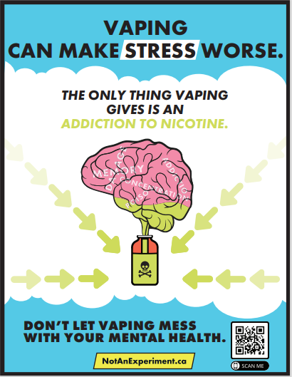

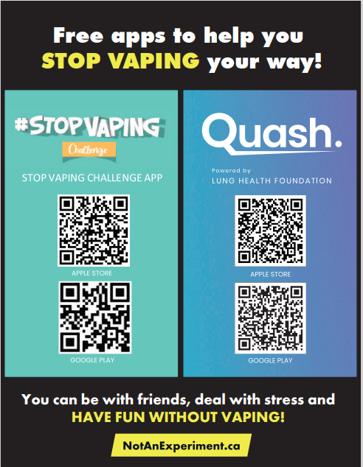
NAE in Secondary Schools
Notes:
Not An Experiment in a secondary school setting:
Similar to the elementary school setting, school administrators, and educators can learn about vaping and the resources available by exploring the NotAnExperiment.ca website. Reviewing the website will provide an understanding of vaping related issues, how to support students in resisting the pressure to vape, where youth can find support to quit, and will provide tools needed to answer questions students may ask.
Schools can use and implement the various resources available at NotAnExperiment.ca/educators. Check with your local public health unit to see what types of support they have available.
To educate students:
Place vaping prevention and cessation posters around the school and place the Ontario law postcards on lockers. By putting these messages front and center, students learn about the health effects of vaping, nicotine addiction, and industry advertising tactics such as flavours, that are used to get people addicted to nicotine. Students also learn about the laws around vaping on school property and the associated fines, as well as ways to access support to quit.
Have the announcements read daily over the PA system to further increase exposure to vape related messaging.
Set up a “Take the clouds outside display”. This supports Smoke-Free Ontario Act compliance, educates about secondhand vapour, supports quit attempts and assists with reducing social exposure to vaping as well as shift social norms.
To educate parents:
Send out ready to use newsletter inserts (8 available covering a variety of vaping related issues parents and caregivers should know about).
Email/send out the Parent & Caregiver Talking Resource and the “Let’s Talk” video series to support them in starting the conversation about vaping with their kids.
All of these actions combined ensure that students are hearing and learning information about vaping from multiple sources, in multiple ways, multiple times. This increases the chances that students will remember the information and will have the tools they need to make informed decisions about their health.

Slide 29

Notes:
Thank you for taking the time to learn about vaping and the Not An Experiment program.
More information can be found on the web site NotAnExperiment.ca.
If you have questions, please feel free to email us at NotAnExperiment@smdhu.org.

